Slide 1




Weakening of the AMOC Abyssal Limb in the North Atlantic
Funding: DeepT award NOAA-OAR-CPO-2021-2006389
Tiago Carrilho Biló, Renelez Perez, Shenfu Dong, William Johns, and Torsten Kanzow
AGU Fall Meeting 2023
December 2023 . San Francisco
Notes:
Hi everyone, today I will talk about the weakening of the AMOC abyssal limb in the North Atlantic
So, when I say abyssal limb of the AMOC, I’m mainly referring to the Bottom Water flow that spreads from Antarctica towards the northern hemisphere below 4000 m

Slide 2
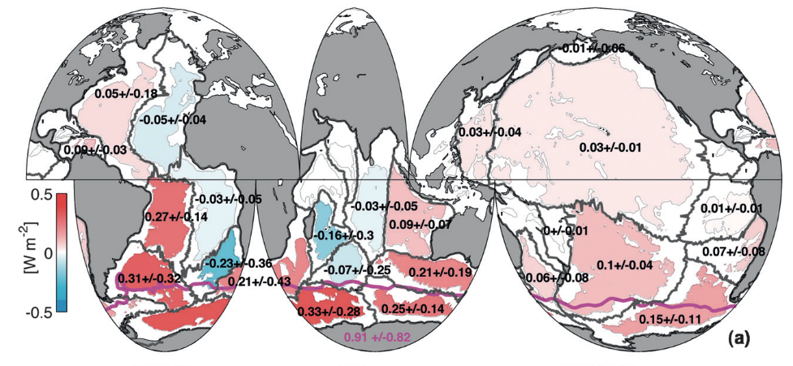
The Global Abyssal Warming and contraction of the AABW layer
Global shrinking of the Antarctic Bottom Water (AABW) layer has driving abyssal warming (z > 4000 m)
Abyssal Heat Content Trends (~1990-2010)
Purkey & Johnson (2010)
Notes:
To contextualize why we are looking at this component of the AMOC, I need tsay hat this abyssal layer is shrinking, driving abyssal warming globally and contributing to SLR.
As we can see in this heat flux map from Purkey & Johnson 2010, with exception of a few areas like the eastern Atlantic and western Indian oceans, the abyssal layers are generally warming due this contraction
The idea behind this is relatively simple, that has been verified in numerical simulations, is that: as the flow slows down, less AABW fills those basins, and the cold layer contracts locally.

Slide 3
The Global Abyssal Warming and contraction of the AABW layer
Global shrinking of the Antarctic Bottom Water (AABW) layer has driving abyssal warming (z > 4000 m)
Abyssal temperature and AABW transport variability in the North Atlantic are surprisingly vigorous (Frajka-Williams et al., 2011)
Warming and weakening trends are uncertain and unclear (Limeburner et al., 2005; Cunningham & Alderson, 2007; Desbruyères et al., 2017)
Notes:
However, in the western North Atlantic, this signal is not as clear as in the western South Atlantic, for example, which corresponds to the main route of the AABW produced in the Weddell Sea
In fact, the abyssal temperature and transports variabilities are surprisingly vigorous, making warming and weakening trends uncertain and unclear in this area.

Slide 4
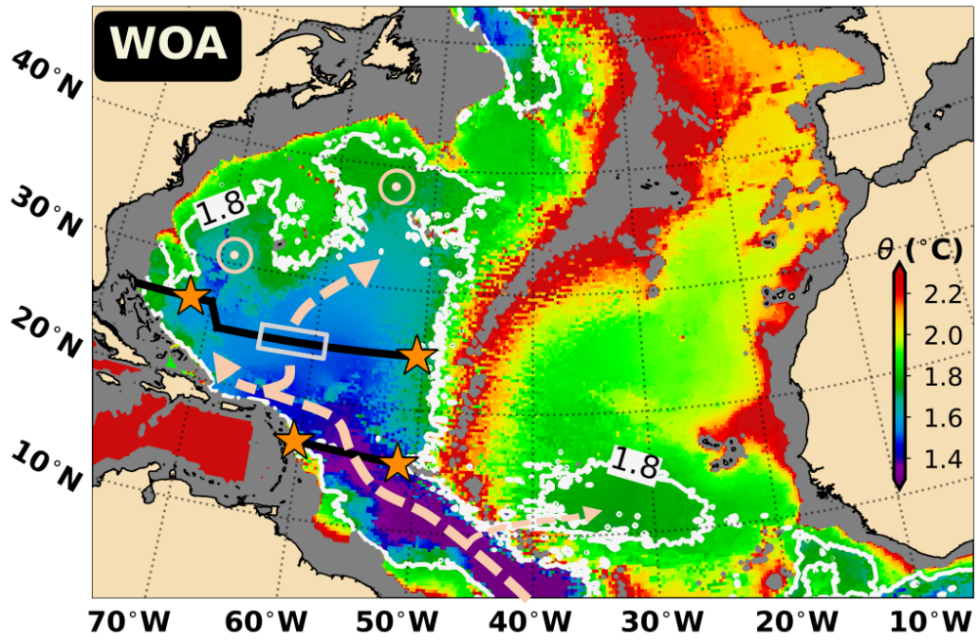
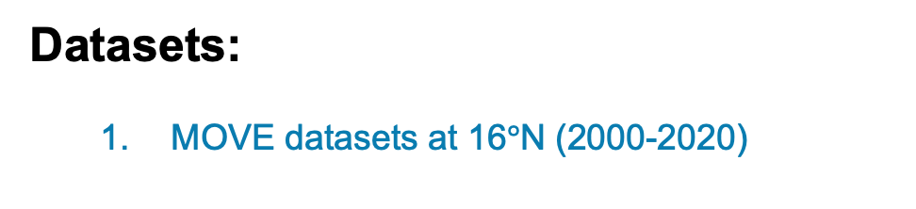

The Global Abyssal Warming and contraction of the AABW layer
The AABW in the North Atlantic ($θ<1.8°C$)
Goals: Investigate the variability of the AABW inflow to the subtropical North Atlantic
Datasets:
  MOVE datasets at 16$°$N (2000-2020)
Schematics Adapted from Talley (2011)
Color Scale: Near bottom temperature; Stars: hydrographic moorings positions
Notes:
Motivated by this, we wanted to check if the abyssal warming and Bottom water contraction are present and persistent in the western North Atlantic after 2000.
To do so, we use the MOVE hydrographic tall moorings at 16N to Study the variability of the AABW flow (stars) (click);

Slide 5
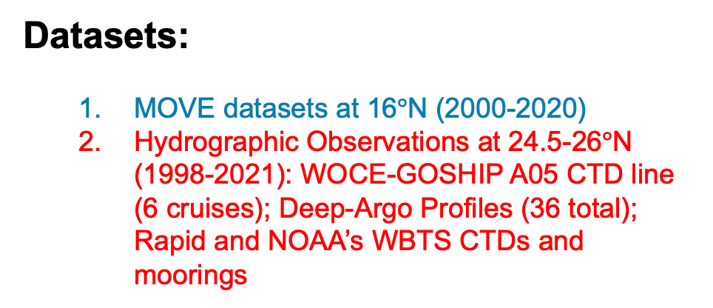
The Global Abyssal Warming and contraction of the AABW layer
The AABW in the North Atlantic ($θ<1.8°C$)
Goals: Study the variability of the AABW inflow to the subtropical North Atlantic and relate this variability to the temperature variations in the area
Datasets:
  MOVE datasets at 16$°$N (2000-2020)
  Hydrographic Observations at 24.5-26$°$N (1998-2021): WOCE-GOSHIP A05 CTD line (6 cruises); Deep-Argo Profiles (36 total); Rapid and NOAA’s WBTS CTDs and moorings
Schematics Adapted from Talley (2011)
Color Scale: Near bottom temperature; Stars: hydrographic moorings positions
Notes:
And then, relate this variability to abyssal temperature variations using a wide collection of hydrographic measurements farther north (click).

Slide 6
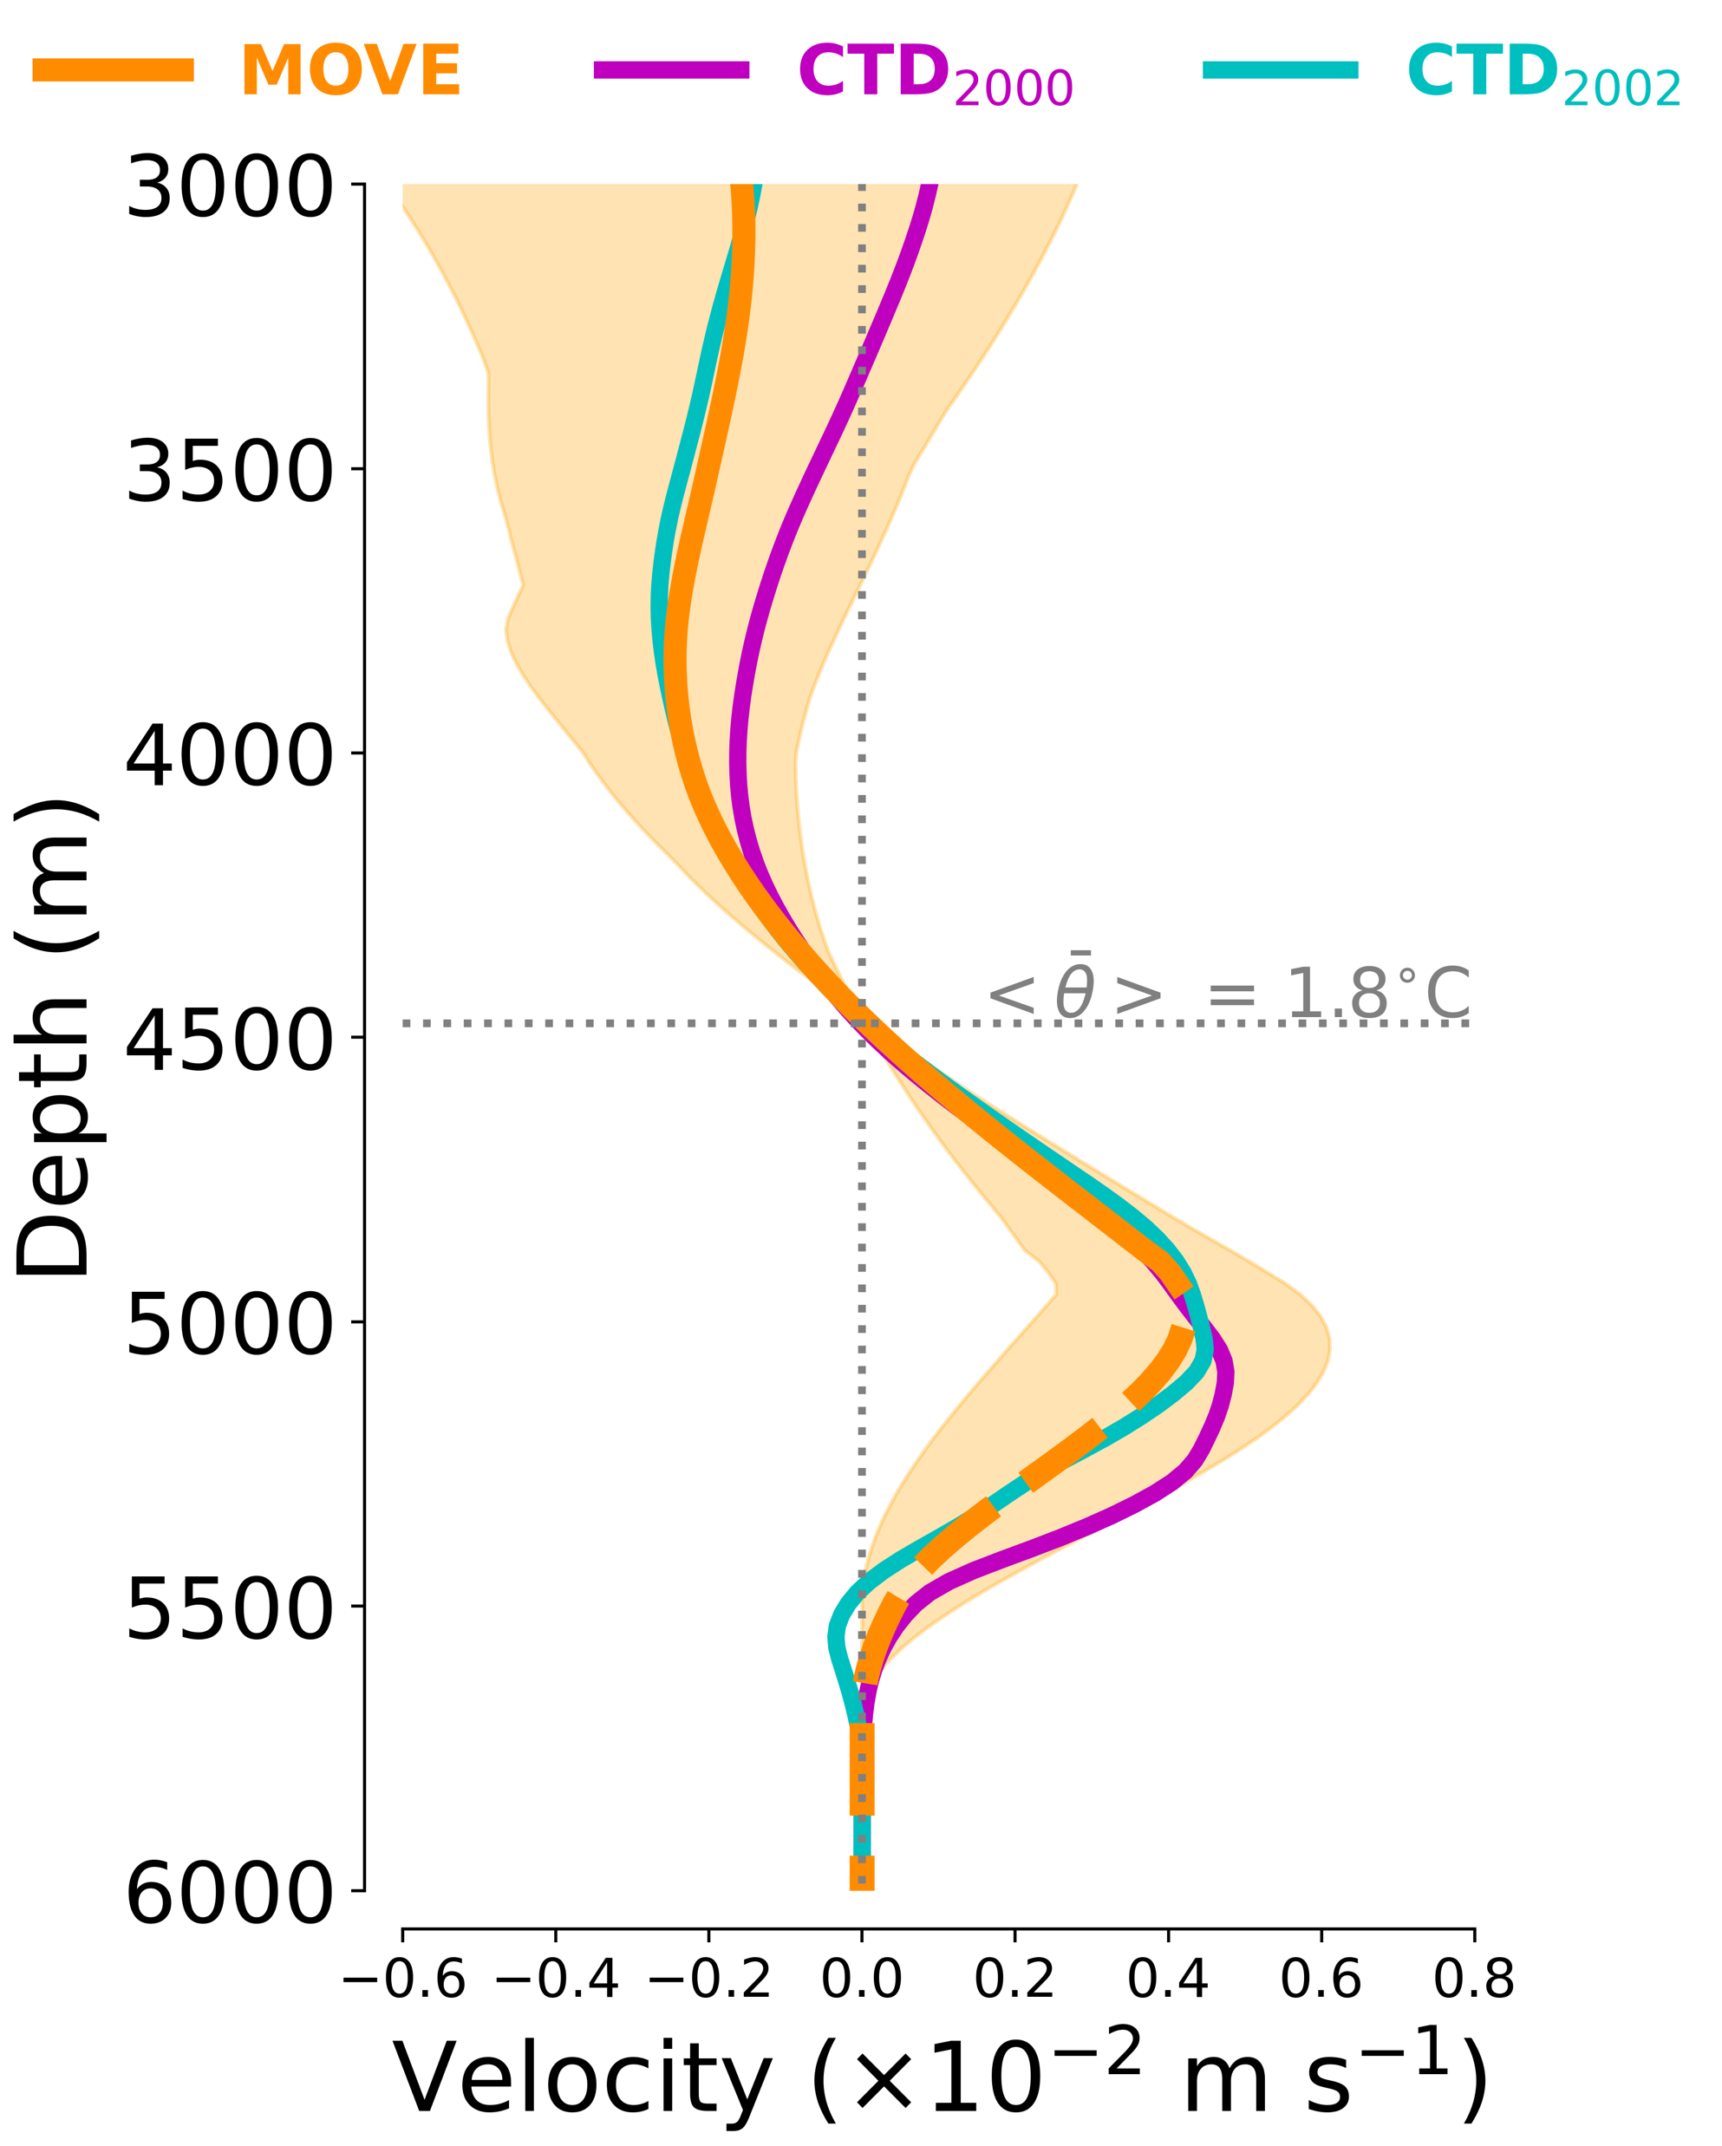

Results: The AABW Transport at 16$°$N
The Geostrophic AABW Transport variability
Mean: 2.40$±$0.25 Sv
AABW flow
Notes:
First things first, lets start with the main result of the study which is the variability of the AABW transport across 16N;
And this is done by calculating the abyssal geostrophic transports using the MOVE tall moorings hydrographic moorings located near the western boundary and the western flank of the Mid-Atlantic Ridge in the east
this is the mean geostrophic velocity profile between the moorings at 16N in orange overlaid with the same calculation done using two CTD transects we had available.
The mean AABW transrport is about 2.40 Sv

Slide 7
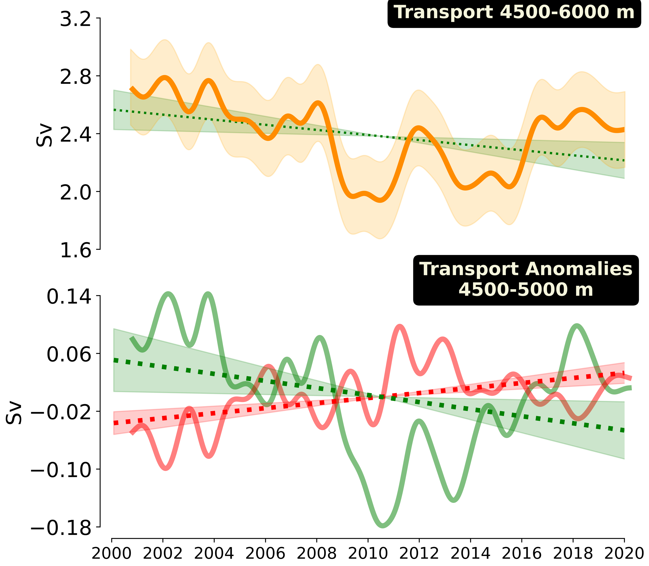
Results: The AABW Transport at 16$°$N
The Geostrophic AABW Transport variability
Mean: 2.40$±$0.25 Sv
Trend = -1.75$±$0.65 ${×10}^{−2}$ Sv/yr ~ 12% reduction in 20 years
18-month low-passed filtered transport
Notes:
and In terms of variability, the abyssal flow presents some significant interannual oscillations on top of a weakening trend of the flow that results in a 12% reduction in 20 years.
Because we use a constant reference level, any variability seen here is associated with changes in the horizontal density gradients across 16N.

Slide 8
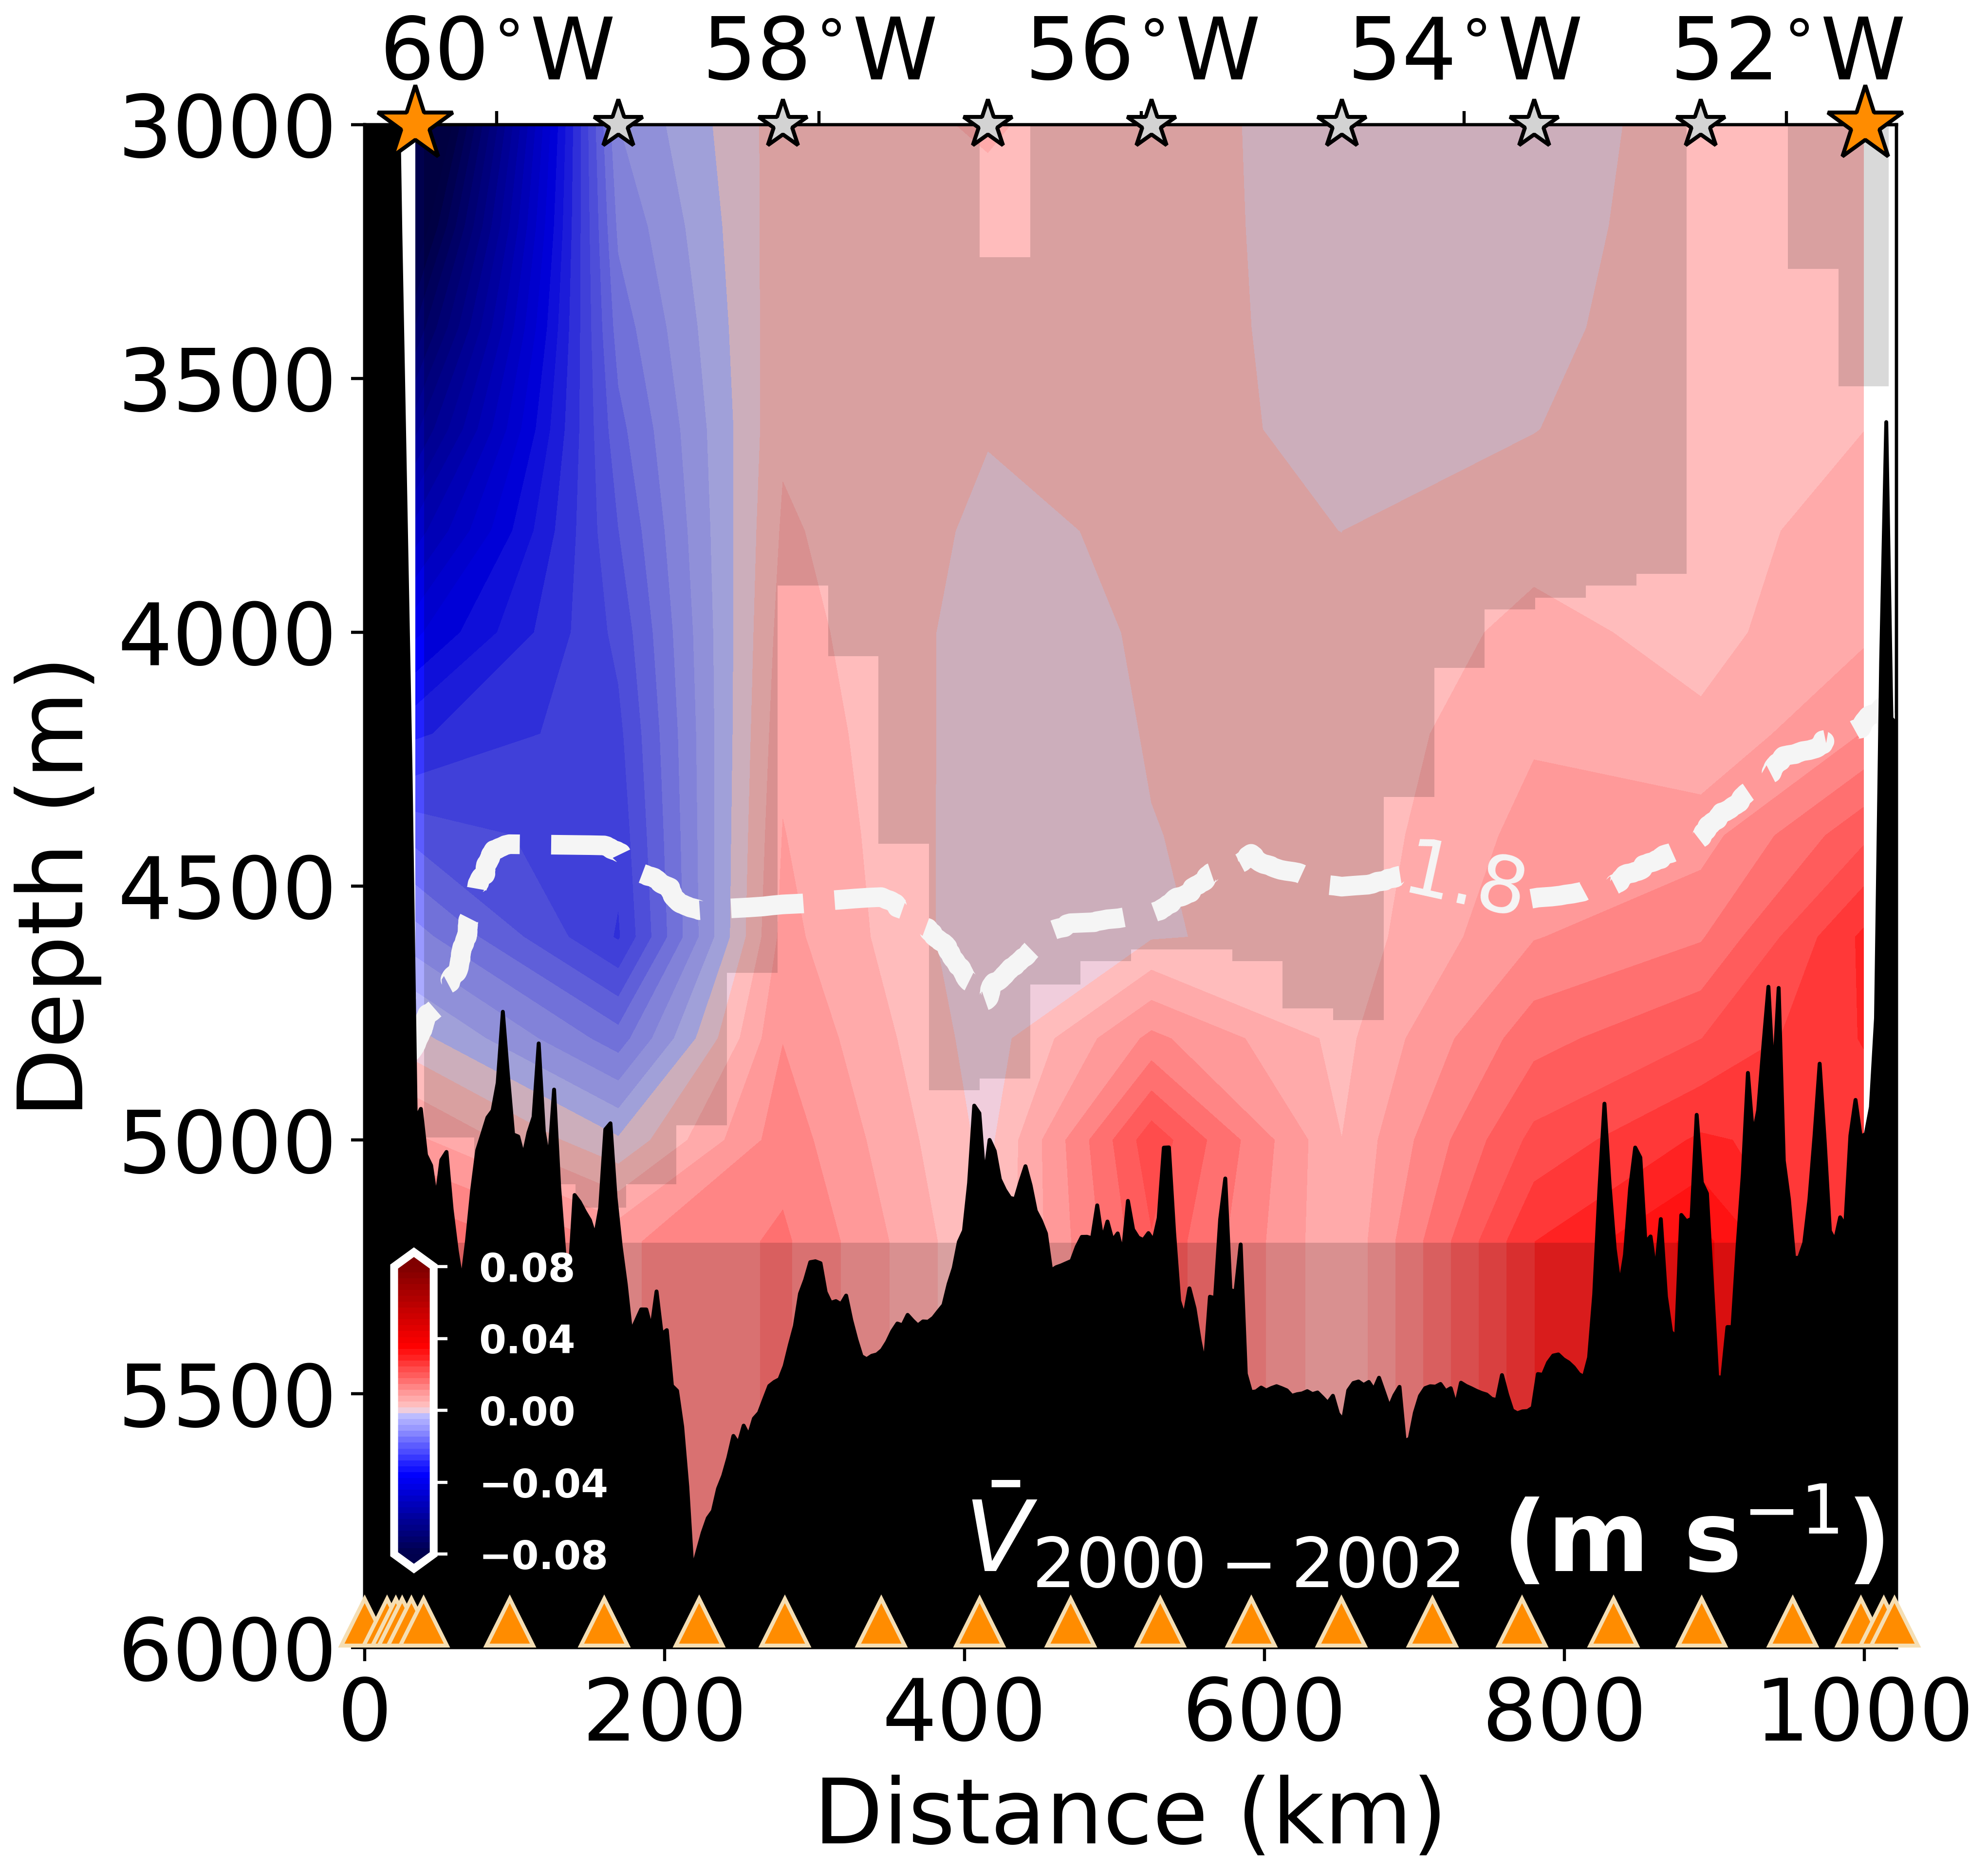
Results: The AABW Transport at 16$°$N
AABW weakening is associated with the contraction of the AABW layer
+ velocities = northward
Notes:
From these current meter mean velocities, we can see that the AABW northward flow is mostly concentrated near the Mid-Atlantic Ridge in the east
As the the AABW flow slows down it forces the isopycnals (and isotherms) to move downwards reducing the horizontal density gradients and, consequently, the geostrophic vertical shear and transports

Slide 9
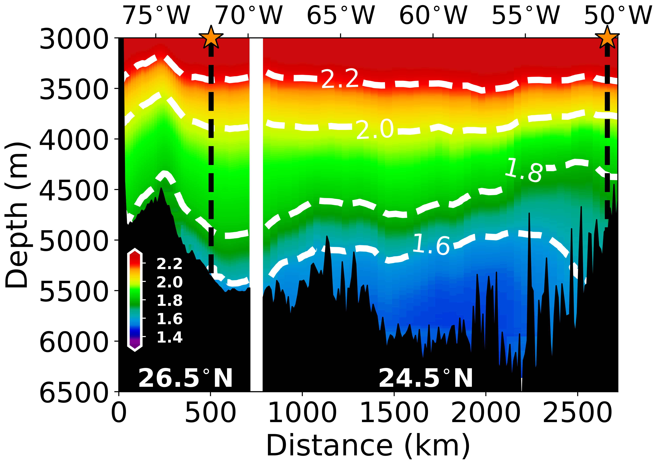
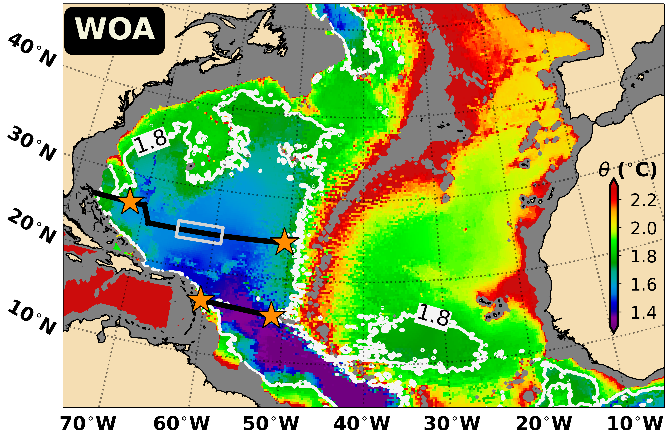

Results: Abyssal Warming in the North Atlantic Subtropics
Potential temperatures at 24.5-26.5$°$N (1998-2021)
AABW layer
36 Deep-Argo profiles
CTDs from WBTS, Rapid, and WOCE-GOSHIP (1998-2021)
Notes:
Ok, so we saw that the AABW flow is weakening at 16N and this weakening is associated with the abyssal warming near the MAR (or the contraction of the AABW). The question that remains is this happening across the entire North Atlantic basin?
Unfortunally, at 16N we only have two CTD transects measuring the entire western North Atlantic basin. However, farther North we have several observational programs that includes WOCE-GOSHIP transects, Deep Argo profiles, WBTS and the well-known Rapid observations
that allowed us to evaluate and map the AABW layer and study its contraction after 2000 (click).

Slide 10
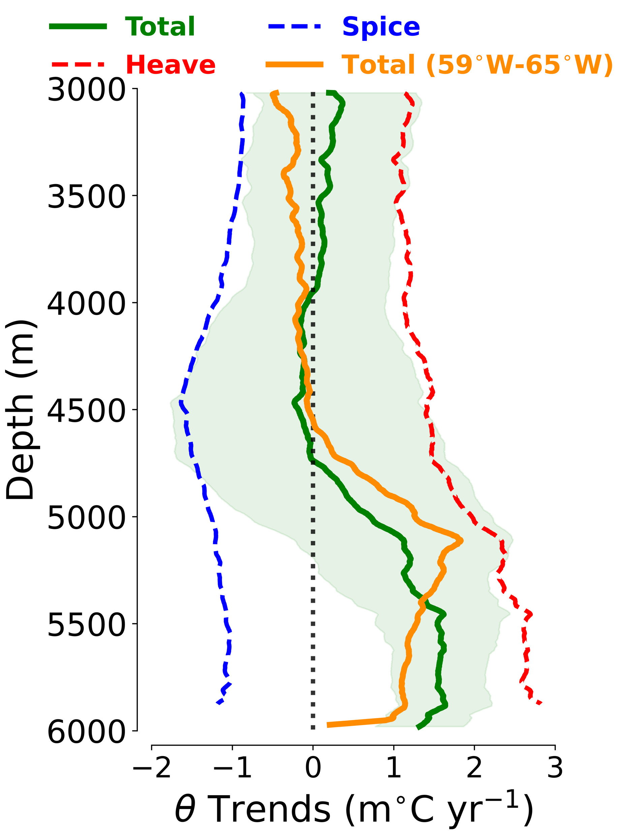
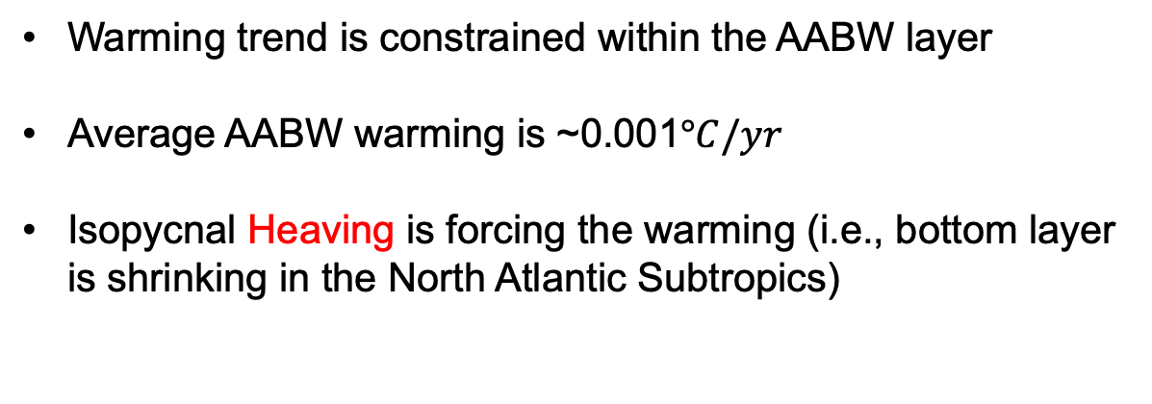
Results: Abyssal Warming in the North Atlantic Subtropics
Potential temperatures at 24.5-26.5$°$N (1998-2021)
Warming trend is constrained within the AABW layer
Average AABW warming is ~0.001$°C/yr$
Isopycnal Heaving is forcing the warming (i.e., bottom layer is shrinking in the North Atlantic Subtropics)
Notes:
Here the green profile is temperature trends at this latitudes, and the orange one is the profile for that smaller area containing the Deep Argo profiles.
From this plot we can see mainly 3 things. One is that the warming trend is constrained within the AABW layer. Note how the positive values are mainly below 4500-4700 m which corresponds to waters colder than 1.8C.
Second is that the average warming of this layer is ~1mC per year.
And the last, but not least, the warming is completely explained by the vertical downward motion of isopycnals (or isopycnal heaving shown by the red profile). If you decompose the temperature anomalies signal into changes along isopycnals (or spice term) + a heaving term, we get that the heaving explains all the warming indicating the contraction of the cold abyssal layer.

Slide 11
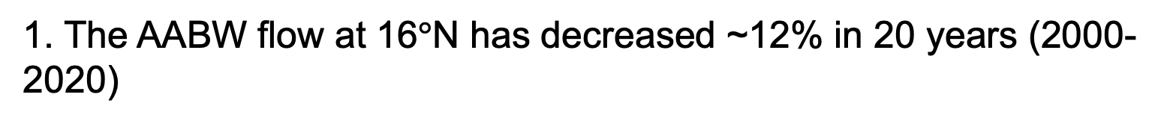
Take-Home Messages
1. The AABW flow at 16$°$N has decreased ~12% in 20 years (2000-2020)
2. The abyssal flow weakening is associated with the contraction of the AABW layer and consequently abyssal warming
3. We estimate warming rates that are on average half of the observed trends in the South Atlantic
QUESTIONS?
Notes:
To conclude my presentation here are the take home messages from all of this:

Slide 12
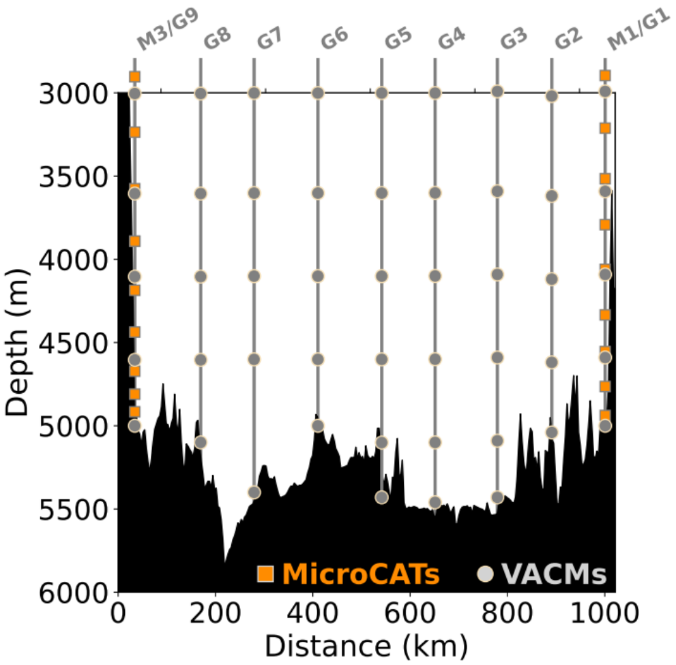
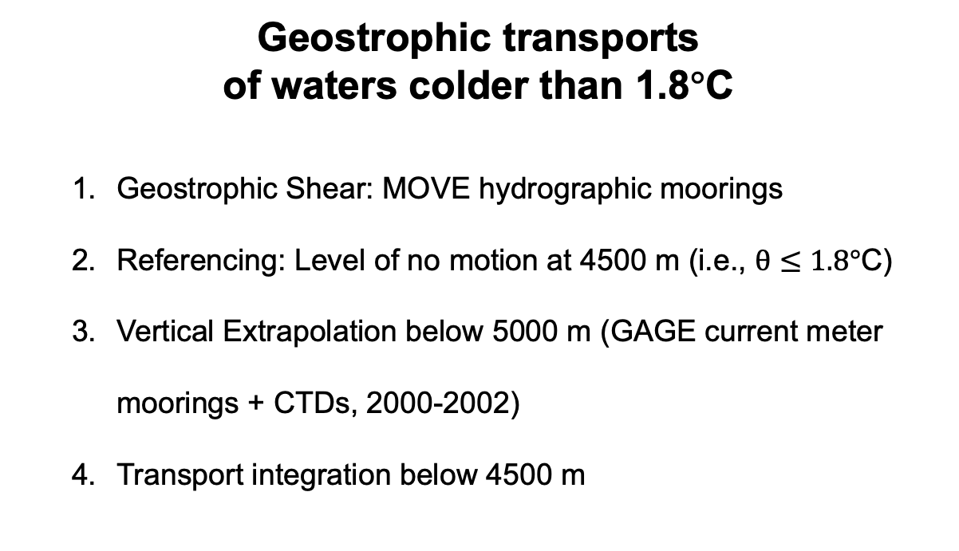

Results: The AABW Transport at 16$°$N
The Geostrophic AABW Transport variability at 16$°N$
Geostrophic transports
of waters colder than 1.8$°$C
  Geostrophic Shear: MOVE hydrographic moorings
  Referencing: Level of no motion at 4500 m (i.e., $θ≤1.8°$C)
  Vertical Extrapolation below 5000 m (GAGE current meter moorings + CTDs, 2000-2002)
  Transport integration below 4500 m
MicroCATs = point-wise CTDs
VACMs = Vector-Averaging Current Meters
Notes:
Following these 4 steps (I will be happy to discuss them further if anyone is interested);

