Slide 1


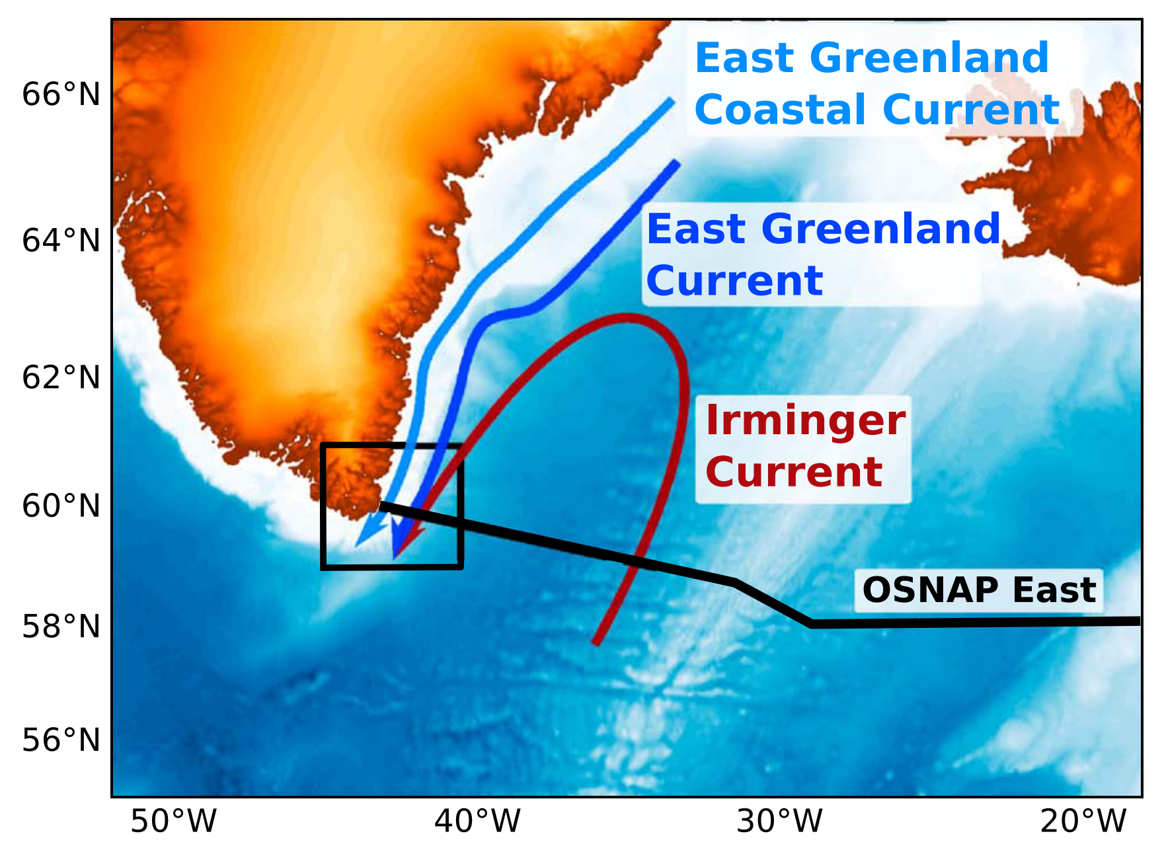

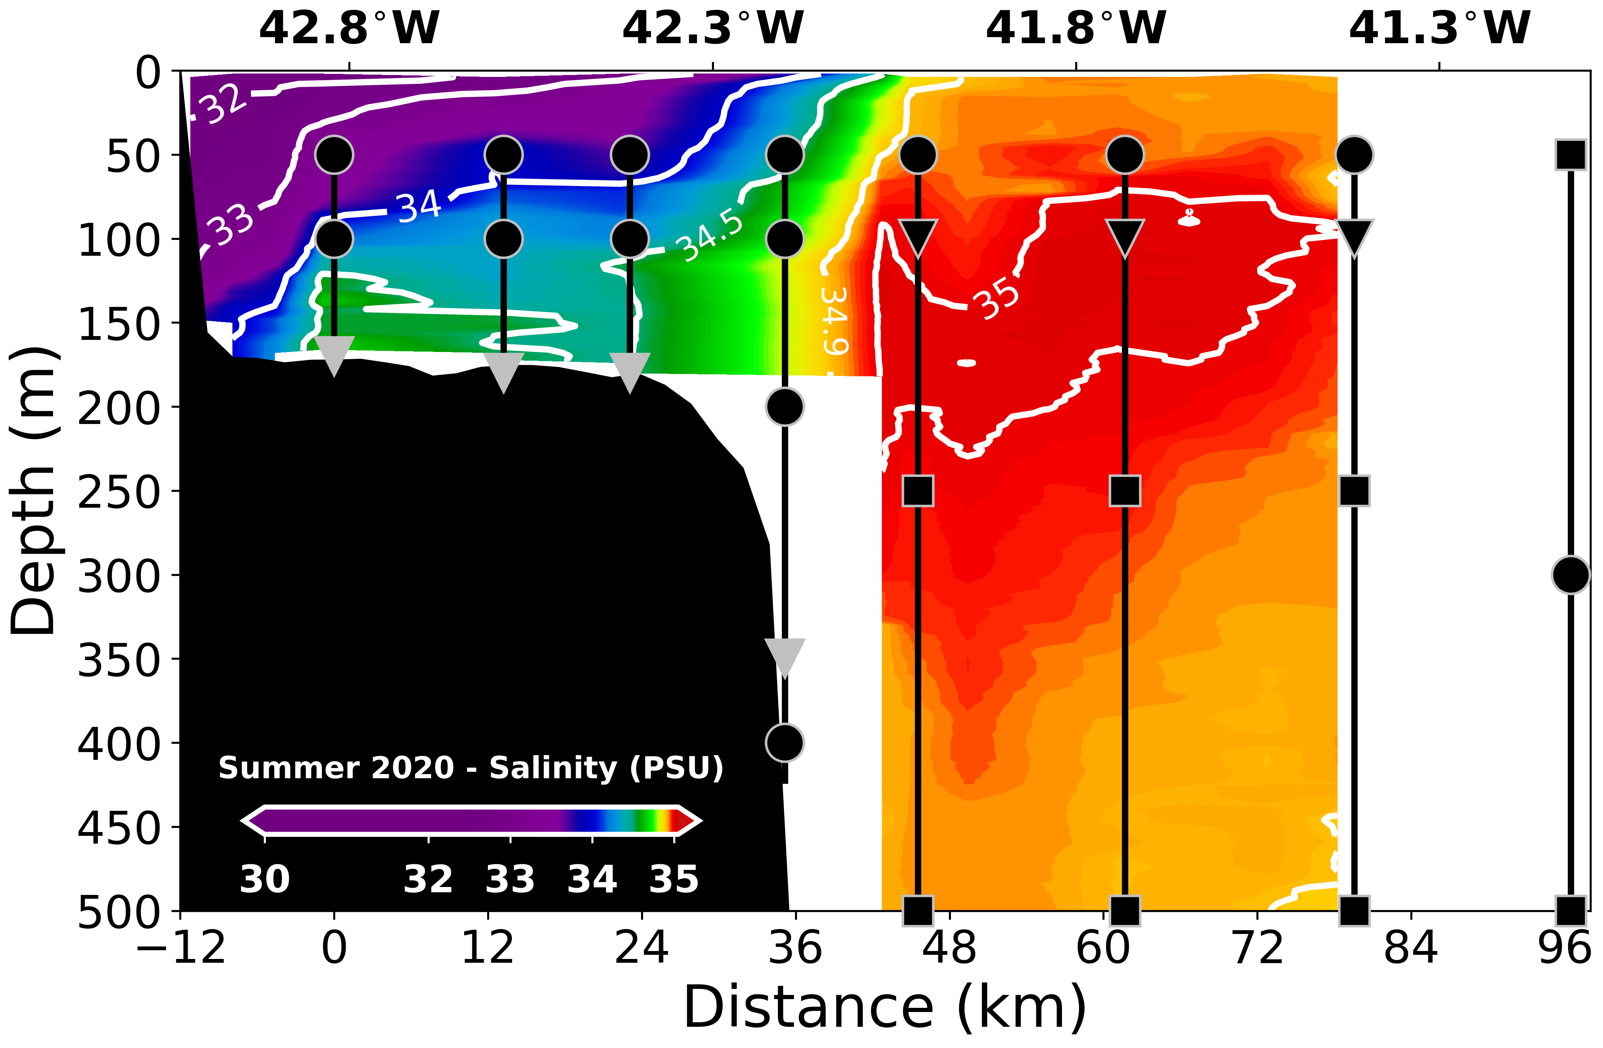
The east Greenland coastal current near cape farewell
Current System
Tiago Carrilo Biló¹, Fiammetta Straneo, and James Holte
¹tcarrilhobilo@ucsd.edu
Le Bras et al., (2018)

Slide 2
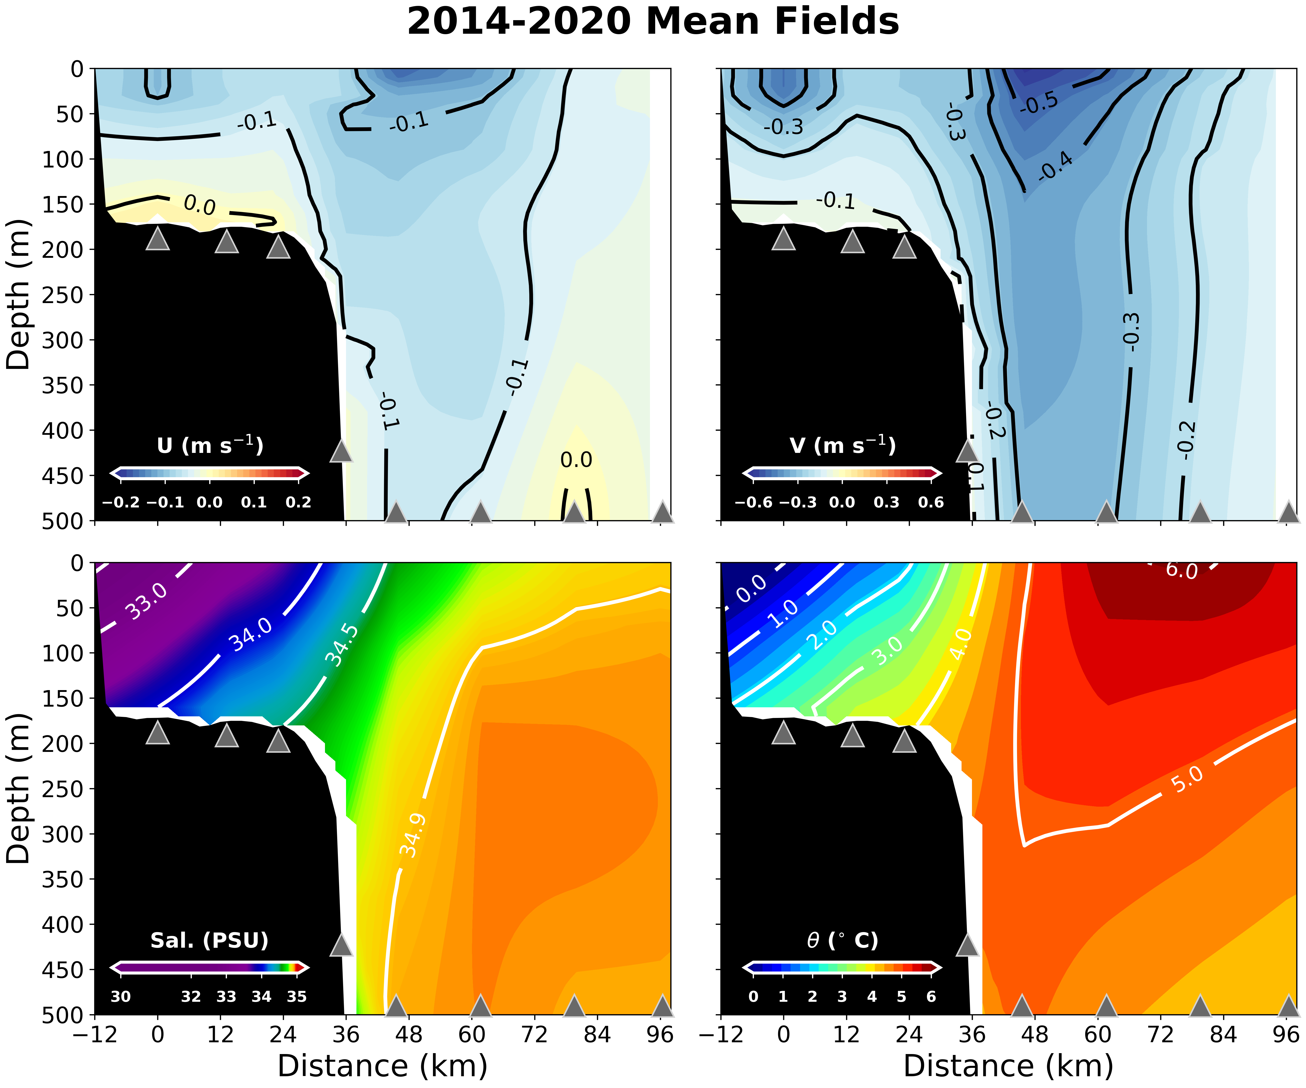
The Mean East Greenland Current System (2014-2020)
1- The Slope Current (EGC + IC) salinity interannual changes and its connection to the basin-wide variability of the Irminger Sea (Biló et al., under review in GRL)

Slide 3
The Mean East Greenland Current System (2014-2020)
2- East Greenland Coastal Current: Transport interannual changes and revisiting its seasonal cycle (some preliminary results)

Slide 4
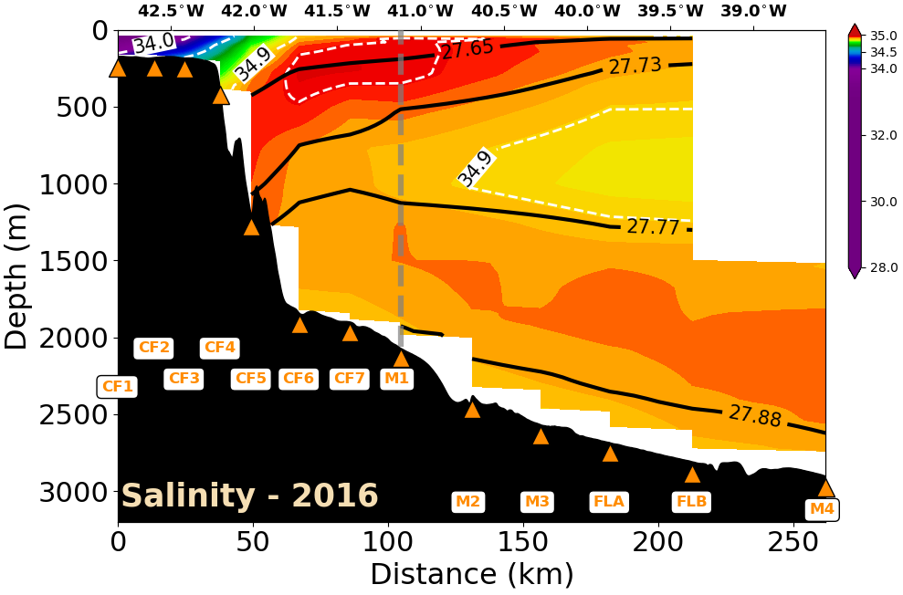
The Slope Current Freshening (2016-2018)
Notes:
Consistent with Pacini et al (2020

Slide 5
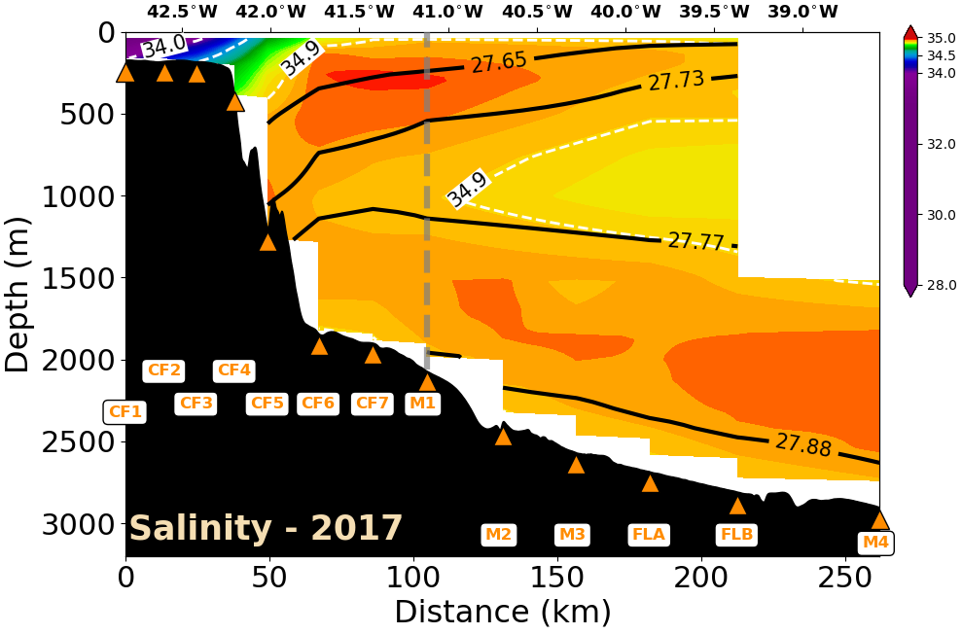
The Slope Current Freshening (2016-2018)
Notes:
Consistent with Pacini et al (2020)

Slide 6
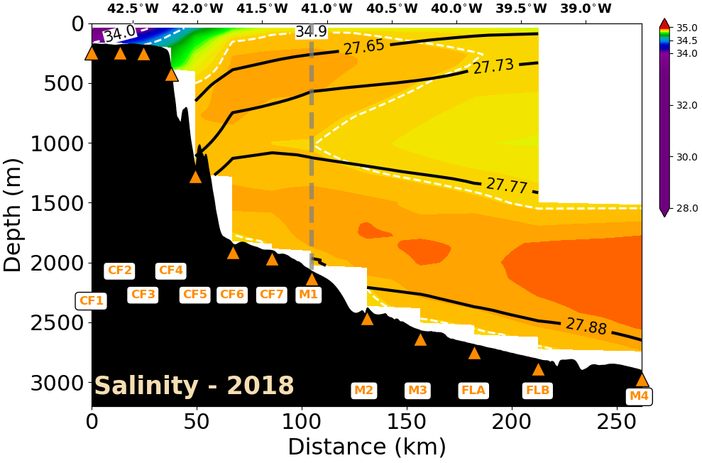
The Slope Current Freshening (2016-2018)
Notes:
Consistent with Pacini et al (2020) observed in west Greenland
Freshening of the SPMW or a decrease in the SPMW formation in the SPNA?
Remember the: SPMW originates from the modification of Subtropical waters from the NAC in the Iceland Basin.

Slide 7
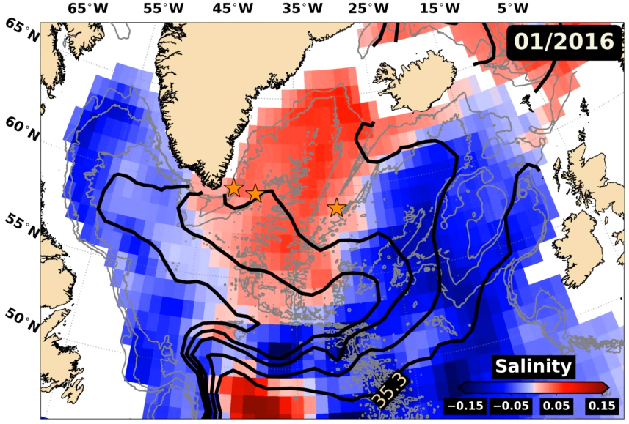
Freshening Source: unprecedented freshening of the Iceland Basin (Holliday et al., 2020)
Salinity anomalies (0-200 m) from Argo data (Roemmich & Gilson, 2009)
Notes:
- The authors show that this event is probably mainly related to the diversion of freshwater from the Labrador Sea continental shelf
- However, the authors also point out that this happened at the same time as the NAO phase was predominantly positive, which indicate less subtropical water entering the SPNA;
Regardless of the driving mechanisms, the authors point out that this anomaly is the strongest anomaly in the past 120 years in the Iceland Basin and the excess of freshwater in the SPNA is similar to the GSA of the late ’60s.
And propagated to the Irminger Sea bla bla bla

Slide 8
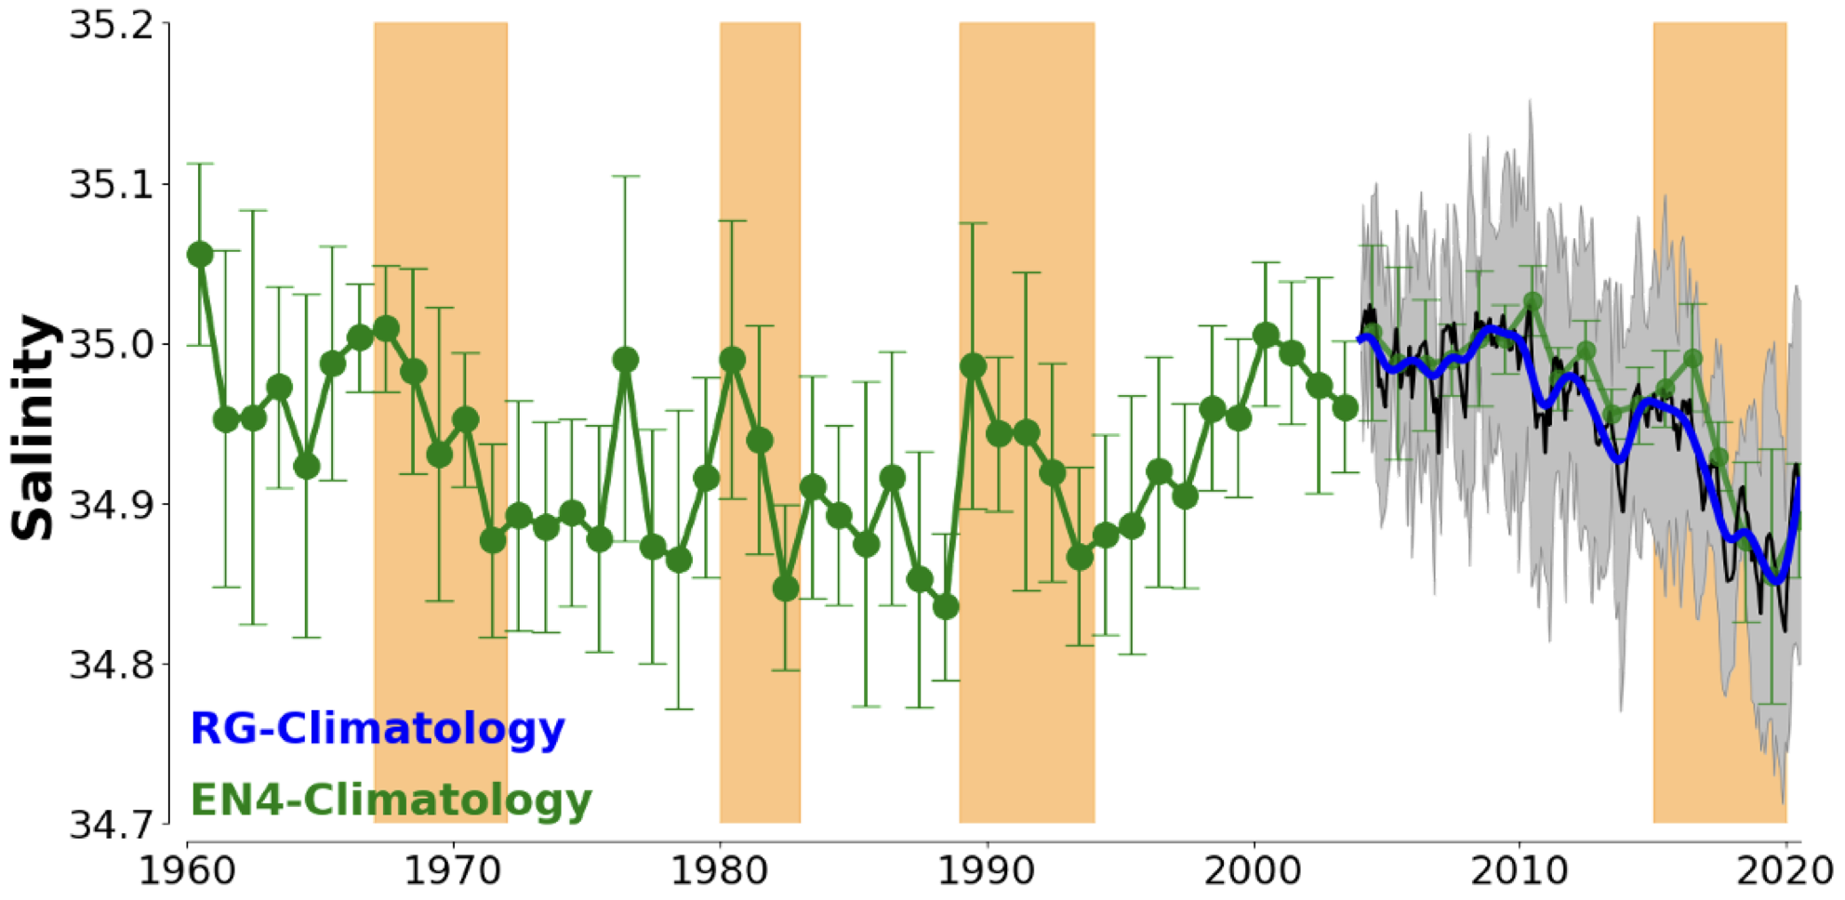
The basin-wide freshening (0-200 m)
Average salinity of the upper Irminger Sea
Great Salinity Anomalies of the SPNA (e.g., Belkin et al., 1998)
Notes:
Based on its strength
Freshwater content
Advection by the large-scale circulation we think it is appropriate to refer to this event as a New Great Salinity Anomaly of the SPNA

Slide 9
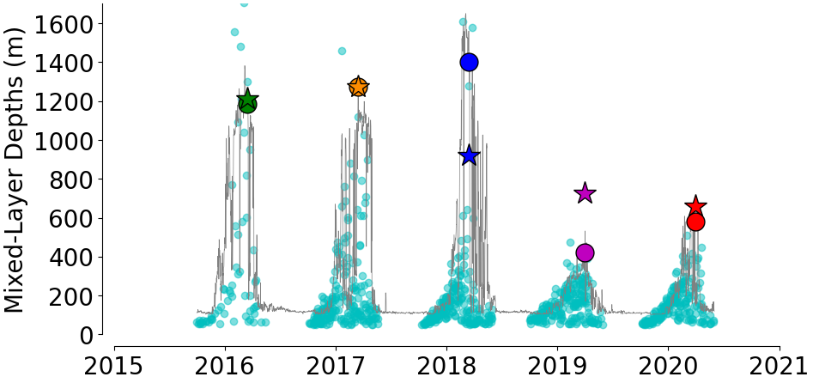
Freshening played an active role in suppressing deep convection
Winter Mixed Layer Depths from mooring and Argo profiles in the central Irminger Sea
Freshening period
Line = MLDs in the central Irminger Sea (mooring)
Cyan Small Circles = Argo MLDs

Slide 10
Freshening played an active role in suppressing deep convection
PWP simulations: Big Circles (Realistic atmospheric forcing); Stars (Constant average atmospheric forcing)
Freshening period
Notes:
During the freshening period the stratification was modified by salinity changes (not temperature). Temperature actually decreased!

Slide 11
Take home Message
Fresh anomaly identified in the Iceland Basin exhibits characteristics of a GSA as it spreads into the Irminger Sea (Fresh Water Content + Strength + Advection + Significant convection weakening)

Slide 12
The east Greenland coastal current (preliminary results)
Transport interannual changes and revisiting its seasonal cycle
Notes:
After talking about the basin-wide freshening: the first thing that comes to mind is: is the freshening affected the continental shelf?
And the answer seems to be yes, but the changes is constrained to the so-called Atlantic Water layer and to the interannual variability.
Otherwise, the shelf variability does not follow what is happening offshore and vice-versa.

Slide 13
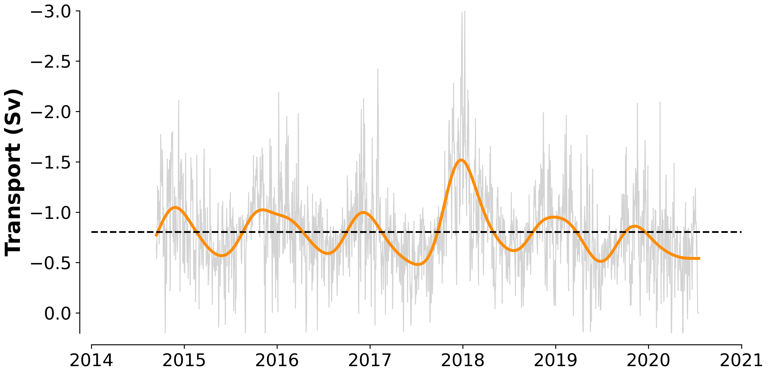


The EGCC transport variability
Freshwater Transport (Ref. = 34.9 PSU) = -36.25$±$13.12 mSv
Heat Transport = -4.4$±$1.3 x10⁻³ PW
-0.80$±$0.26 Sv
Daily transports (40h low-pass)
Peaks on late Fall: Nov. to early Jan.
6-month low-pass. transports
Minima on spring: May to Jul.
Notes:
But we have other exciting results to show and that is the extension of the OSNAP results using the 6-year long time series;
Remember to mention the uncertainty takes into account the statistical uncertainty and different extrapolation schemes.

Slide 14
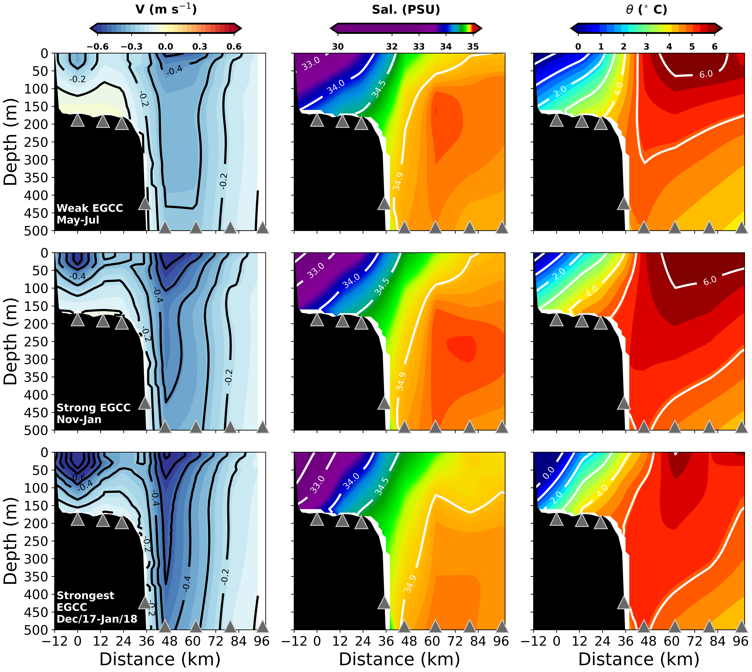
Seasonal Extremes
Transport = -0.57 Sv
Transport = -1.08 Sv
Transport = -1.65 Sv

Slide 15
Seasonal Extremes
Transport = -0.57 Sv
Freshwater = -23.58 mSv
Transport = -1.08 Sv
Freshwater = -52.16 mSv
Transport = -1.65 Sv
Freshwater = -90.29 mSv
Notes:
Remember to mention: density mainly is salinity dominated so we can see the isopycnals’ slope increasing with transport indicating the buoyancy importance;

Slide 16
Seasonal Extremes
Heat = -2.8x10⁻³ PW
Heat = -8.7x10⁻³ PW
Heat = -7.2x10⁻³ PW
Notes:
It is important to mention that these extremes do not correspond the maximum and minima of Heat Transports because temperature is out of phase with the EGCC transport and salinities (will get to that); The values here are not exactly meaningful extremes of heat transport.
IC and EGCC changes are not correlated. The IC strengthening, freshening, and cooling is actually related to the SPG strengthening and changes with the SPMW properties.

Slide 17
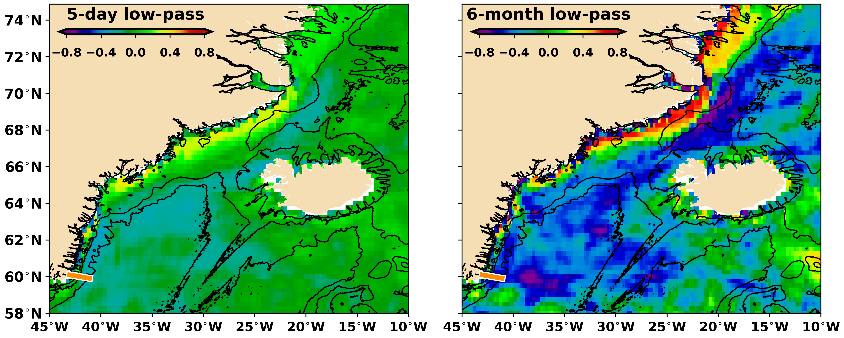
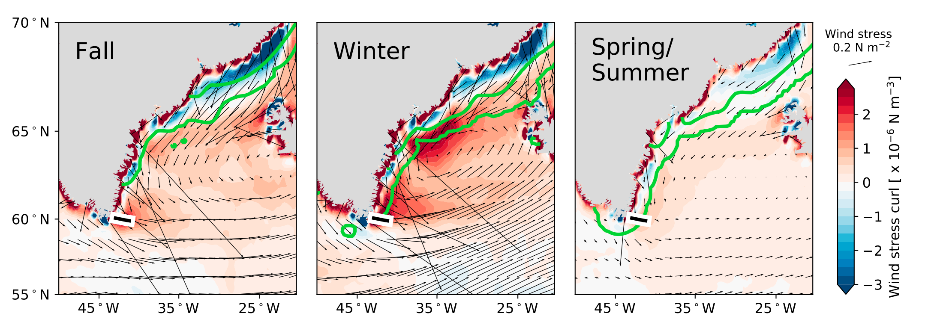
The EGCC transport Seasonal Cycle
The wind forcing (e.g., Sutherland & Pickart, 2008; Bacon et al., 2014; Harden et al., 2014; Le Bras et al., 2018; and others)
EGCC Transport and Wind Stress Curl (i.e., Ekman transport divergence/convergence) from ERA5
Le Bras et al., (2018)
Notes:
First, we need to stablish where the wind forcing is more significant (remote vs local) following Isabela’s idea;
Result = disappointedly low correlations (similar to Le Bras work);

Slide 18
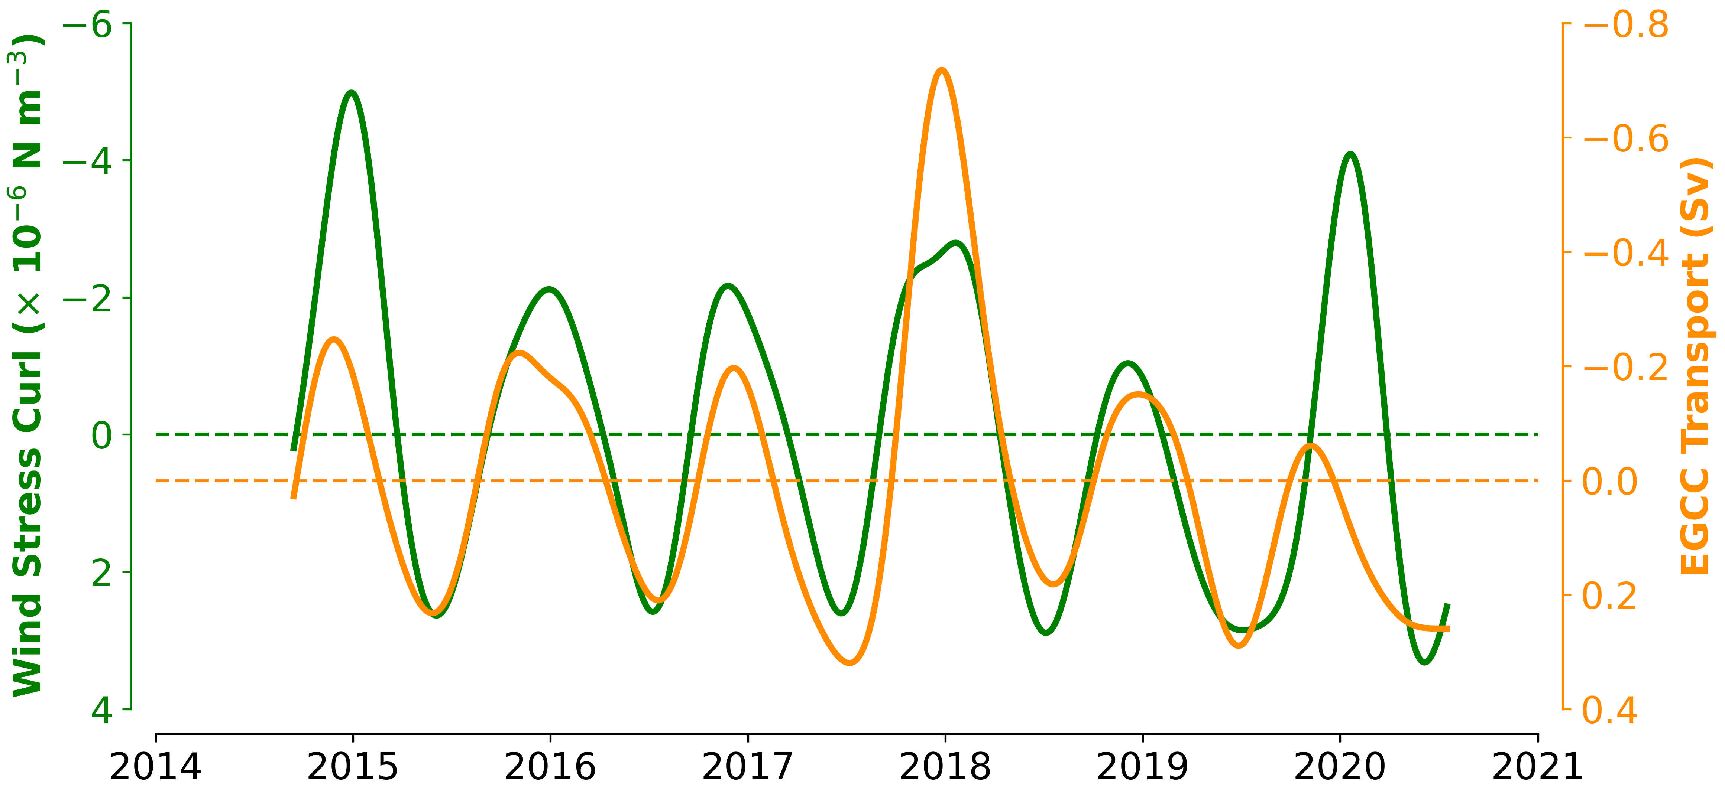
The EGCC transport Seasonal Cycle
Spatially averaged wind stress curl (over downwelling regions) and transport anomalies
Notes:
Wind stress curl here is the spatially averaged curl over areas with large correlation (r > 0.7)
Correlation is great but not perfect. The transport follows the curl but there are periods that are exceptions like …

Slide 19
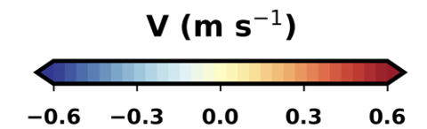
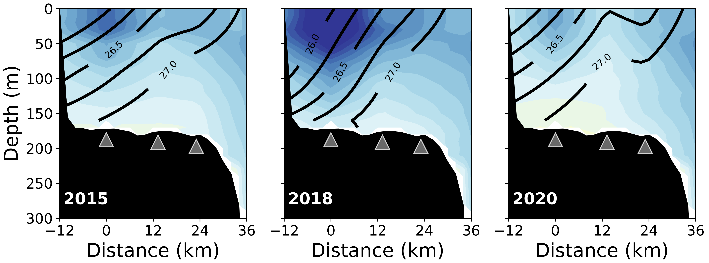
The EGCC transport interannual variability
Buoyancy forcing?
Lines = potential density isopycnals
Notes:
In 2018, the slope of the isopycnals is larger than the periods. We can see that the EGCC general density is lower which impose a steric height increase compared to the other years.
This indicates that when the buoyancy forcing is in phase with the wind forcing the transport can be enhanced quite a bit.
Note the isopycnal tilt is more significant close to the coast. Offshore CF2, the slop almost does not change. This indicate, the density of the EGCC core is a good proxy of the buoyancy forcing.

Slide 20

Conclusions
EGCC volume transports from the 6-year long OSNAP time series: i. Mean: -0.80$±$0.26 Sv (-36.25$±$13.12 mSv); ii. Amplitude ~0.5 Sv (25 mSv) with iii. Maxima in Nov-Jan and Minima in May-Jul
Seasonal cycle forcing: Ekman driven downwelling along the East Greenland coast north of 64ºN
Hypothesis and future work
Buoyancy forcing seems to modulate the transport seasonal cycle from year to year
A lot of work to be done: Extrapolations uncertainties (OSNAP + WOCE + OVIDE); Drivers of the cross-section TS distribution over the shelf (wind x buoyancy x eddies);
Notes:
It if worth mentioning again that we still need to work on better understanding the extrapolation uncertainties (at least during summertime when we can include OSNAP + OVIDE sections comparisons) when the buoyancy forcing can be significantly underestimated.
Quantify the forcing in terms of velocity and transport similarly to what Bacon et al., (2014) have done and that should include local and remote wind forcing, and buoyancy.

Slide 22
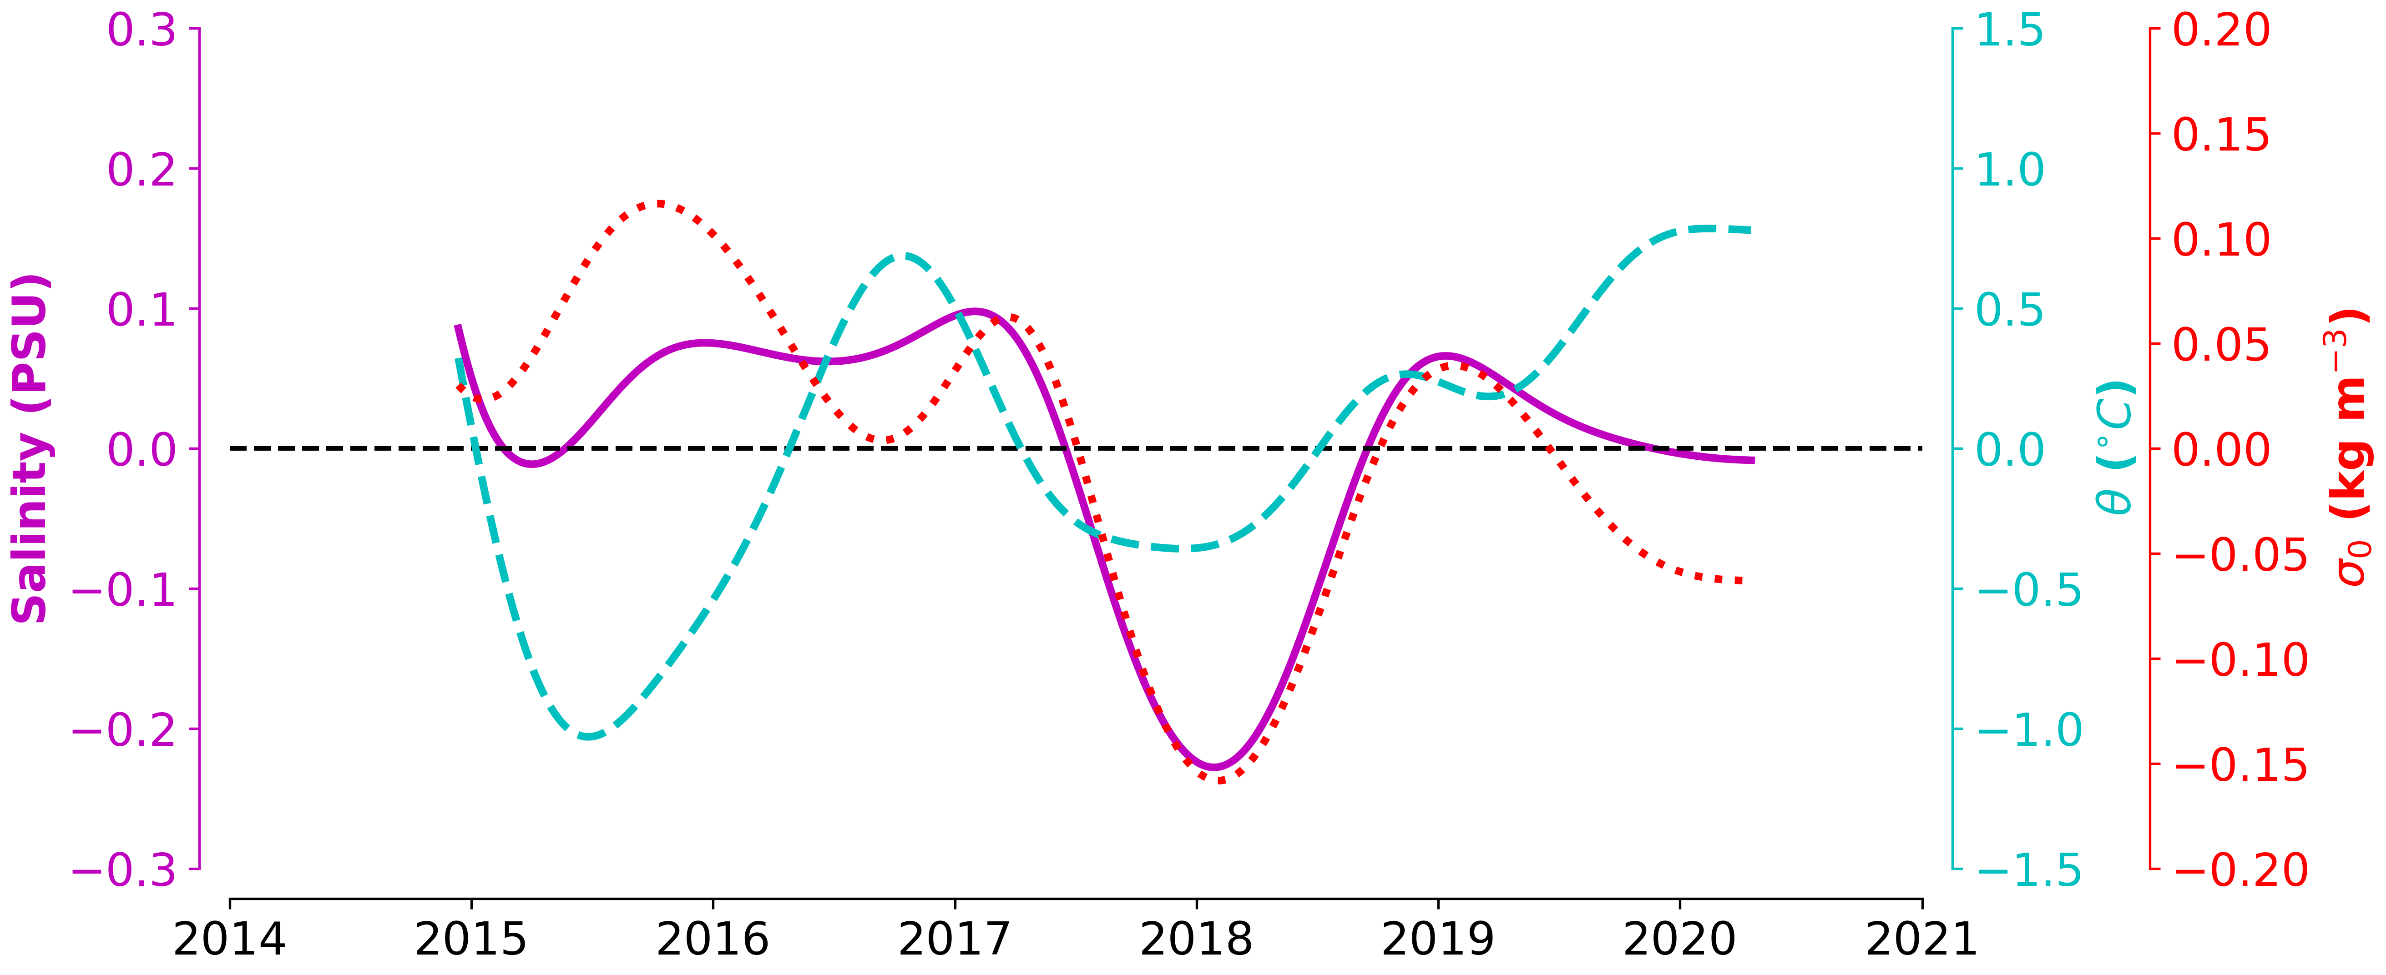
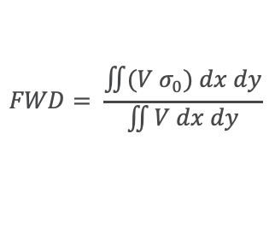
The EGCC interannual variability
18-month low-pass. EGCC flow-weighted properties anomalies
$$FWD= \frac{\iint{(V σ_{0}) dx dy}}{\iint{V dx dy}}$$
Notes:
Flow weighted properties reflect the “average” properties of the EGCC velocity core
Two interesting events: 1- the anomalous strong 2015 winter
2- The anomalous fresh and colder 2017-2018 years that contributed to the strengthening of the EGCC
3- Note how the EGCC is getting warmer and fresher over time
Why the

Slide 23
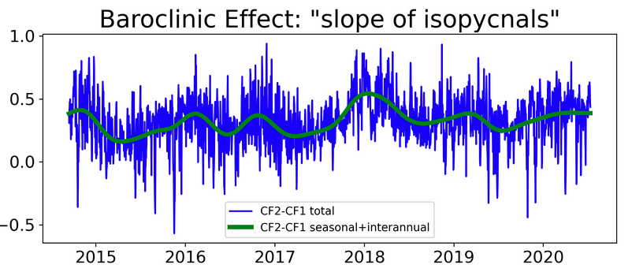
The buoyancy forced EGCC acceleration
Density difference (Kg m⁻³)

Slide 24
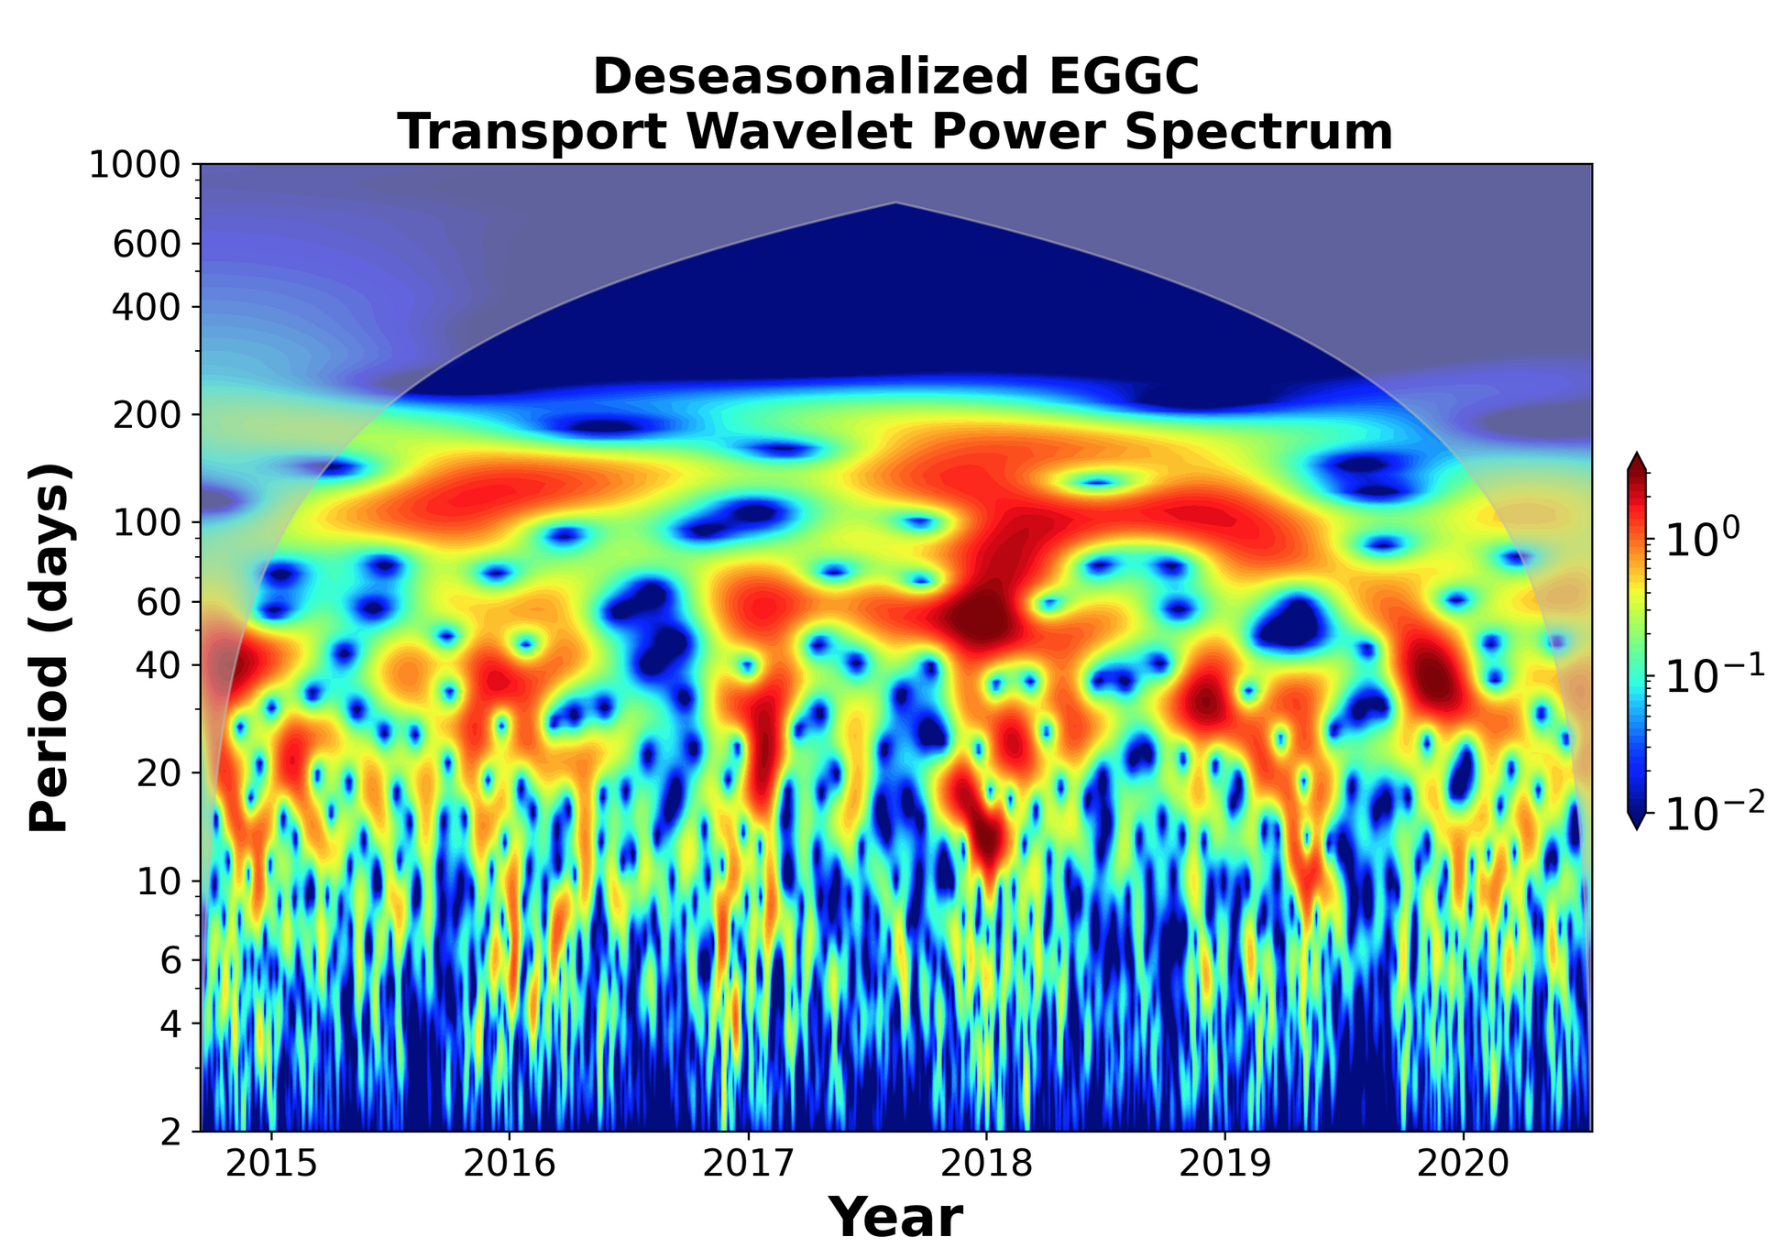
The meso and shorter time scales

