Slide 1

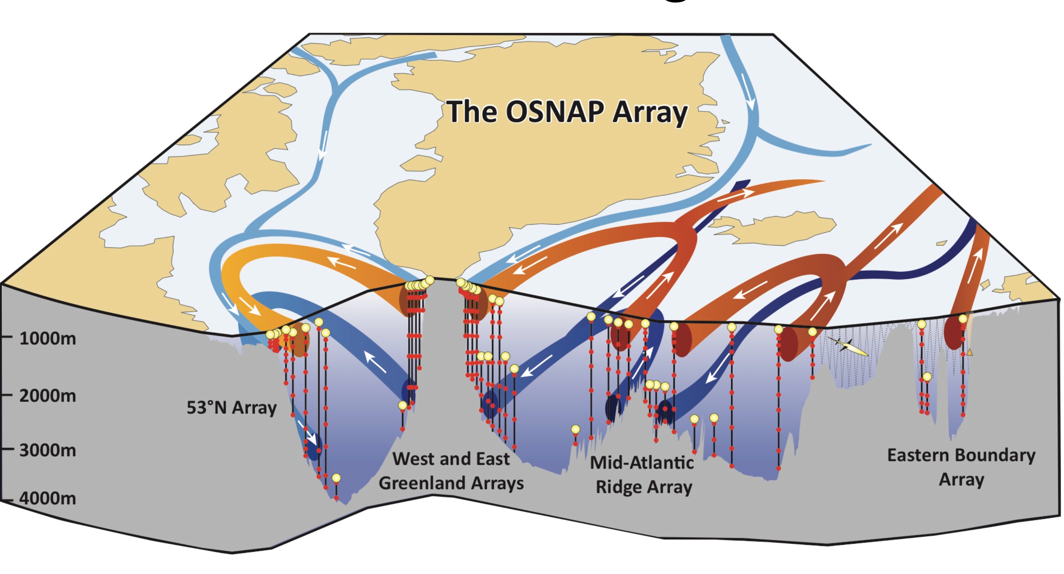




On the recent freshening of the irminger sea (2015-2020)
Tiago Carrilo Biló¹, Fiammetta Straneo, James Holte, and Isabela Le Bras
¹tcarrilhobilo@ucsd.edu
Irminger Sea
https://www.o-snap.org/
Notes:
Good morning, good afternoon, or good evening depending what time you are watching this presentation …
My name is Tiago and in this video, I will show some results on my research about the recent freshening of the Irminger Sea (click) …
Which is located between Greenland and the portion of the Mid Atlantic Ridge know as the Reykajnes Ridge;
This research was conducted in collaboration with my coauthors from the Polar Center at Scripps Institution of Oceanography and …
From Woods Hole Oceanographic Institution …
This work is part of the OSNAP project funded by NSF, that aims to observe the Subpolar North Atlantic Meridional Overturning Circulation (represented here by the arrows) using a series of velocity and hydrographic mooring arrays (little vertical lines) (click)

Slide 2
Deep water production, and heat and carbon sequestration can be affected by salinity
Winter convection in the Irminger Sea results in ISIW: ISIW + LSW constitutes the upper-NADW (Le Bras et al., 2020)
Deep convection (i.e., depths > 1000 m) is intermittent and sensitive to the right conditions (e.g., de Jong et al., 2012)
ISIW = Irminger Sea Intermediate Water
LSW = Labrador Sea Water
NADW = North Atlantic Deep Water
Irminger Sea
Atmospheric conditions
Ocean Stratification prior to convection (i.e., salinity matters)
https://www.o-snap.org/
Notes:
So why do we care about the Irminger Sea or freshening events in this area? Well, besides being in the path of the overturning circulation,
the Irminger Sea is an important site for the production of the so-called North Atlantic Deep Water, and consequently important for sequestration of carbon and heat from the atmosphere every year (click);
Specifically, during the wintertime, convection in the Irminger Sea produces the Irminger Sea Intermediate Waters that together with the Labrador Sea Water, they form the upper portion of the North Atlantic Deep Water (click) …
Now, like other regions of the Subpolar North Atlantic, the strength of convection depends on (1) the winter atmospheric conditions
and …
(2) On the ocean stratification – or how vertically mixed the ocean is before convection happening
And this is why we care about freshening of the ocean. Changes in salinity impact the ocean stratification!
So, what can we say about the recent changes in the salinity of this region? (click)

Slide 3
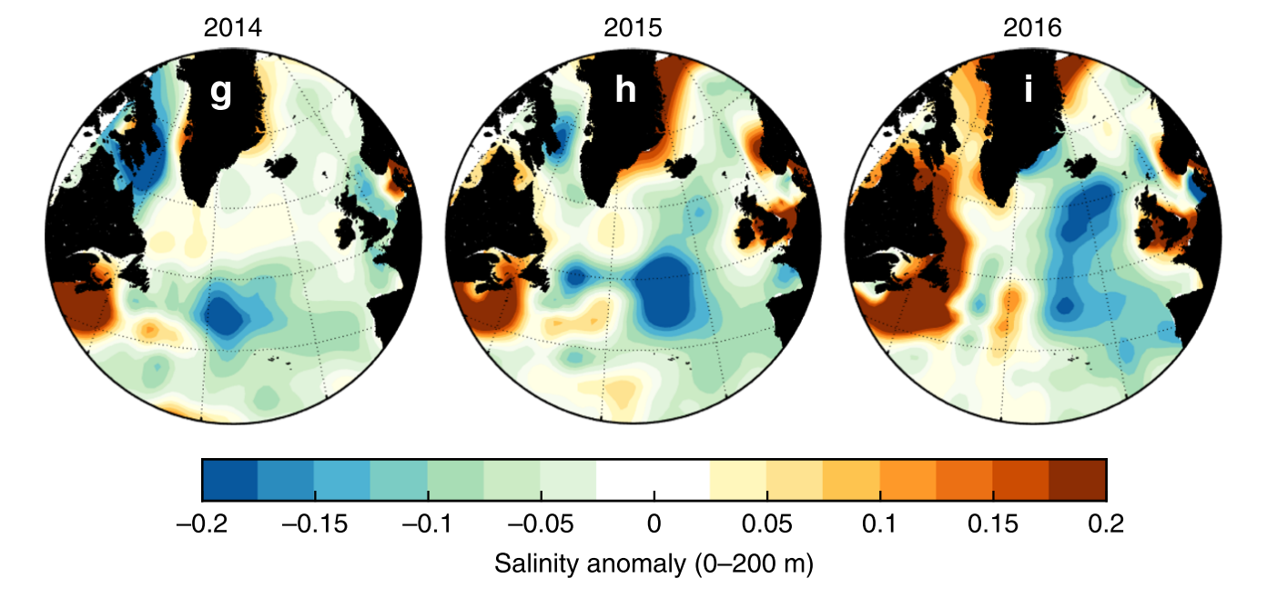
Holliday et al. (2020) reported an unprecedented freshening in the Iceland Basin and its potential propagation towards the Irminger Sea. Is this a new Great Salinity Anomaly (e.g., Belkin, 2004)?
Strongest salinity anomaly of the past 120 years that probably propagated into the Irminger Sea
Adapted from Holliday et al. (2020)’s Fig. 2
Notes:
For starters (click) a study led by Penny Holliday showed that, before 2016, an unprecedented salinity anomaly developed in the neighboring basin (a.k.a the Iceland Basin).
That was generated by an anomalous atmospheric redistribution of freshwater originated in the Labrador Current and continental shelf areas ...
You can see this strong anomaly represented by the blue negative salinity values in the upper 200 m of the water column
propagating eastward and then northward in their figure (click) …
The authors also show that this is the strongest salinity anomaly ever recorded in the Iceland Basin, and
the subpolar gyre’s cyclonic circulation started advecting this signal westward towards the Irminger Sea.
Now, for those of you familiar with the subpolar gyre … strong salinity anomalies being advected by the circulation are not new. In fact, a few of them happened before,
and they are referred as Great Salinity Anomalies. Although, the sources of the different Great Anomalies differ from this one, their unprecedented strength and propagation seem consistent (click).

Slide 4
Goal
Document the arrival, spreading, and impact on convection in the Irminger Sea of this new “Great Salinity Anomaly (GSA)” between 2015-2020
Data and approach
Hydrographic monthly climatologies
RG-climatology (Roemmich & Gilson, 2009)
EN4-climatology (Good et al., 2013)
OOI mooring
ERA5 atmospheric reanalysis (Dee et al., 2011 )
OSNAP and OOI moorings
Salinity anomalies spreading and basin-wide salinity interannual variability
Salinity anomalies spreading rates
Freshening impacts on stratification and convection
Notes:
In that sense our main goal is to document the arrival, spreading and impact on convection in the Irminger Sea of this new “Great Salinity Anomaly (GSA)” between 2015-2020 (click)
And to achieve this goal we study the basin-wide salinity interannual variability using two hydrographic monthly climatologies (click)
Then, we study the anomalies spreading by combining one the climatologies with OSNAP and OOI hydrographic moorings data across the basin (click)
And finally, we investigate the freshening impacts on the convection activity by combining OOI-mooring records and outputs from the ERA5 atmospheric reanalysis(click)

Slide 5
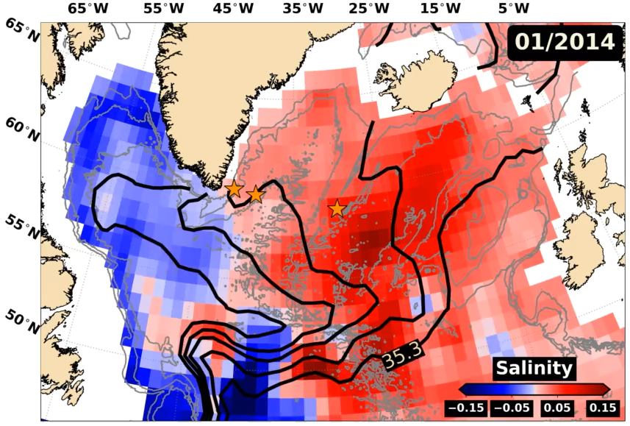
Result 1: Fresh Anomaly propagated into the Irminger Sea causing strong salinity trends between 2015-2020
Salinity anomalies (0-200 m)
Anomalies enter the Irminger Sea mainly over the Reykjanes Ridge
Argo RG-climatology – 18-month low-passed filtered anomalies
Like other GSAs, it is quickly advected by the boundary currents
Cross-correlation between mooring records: ridge-east Greenland transit time = 6-11 months
Slow spreading and accumulation in the interior
Cross-correlation between mooring records: ridge-basin center spreading time = up to 2.5 years
Strong near surface salinity 2015-2020 trends of -0.04 to -0.02 PSU year⁻¹
2004-2014 trends do not exceed -0.01 PSU year⁻¹ (Tesdal et al., 2018)
Black lines = 34.7, 34.8, 34.9, 35.1, 35.3 isohalines
Stars = OSNAP + OOI moorings
Notes:
So, before describing any variability or impacts in convection, we should answer one question: have the Iceland Basin anomaly propagated to the Irminger Sea?
and the short answer is YES! (click)
This animation using the Argo climatological data…
shows that the fresh anomalies in the upper 200 m of the ocean (or negative values)…
propagate cyclonically from the Iceland Basin to the Irminger Sea (click);
In fact, the anomalies enter the Irminger Sea mainly over the Reykjanes Ridge in late 2015 (click) and
Get quickly advected around by the boundary currents,
which usually takes between 6 to11 months on average, (click) …
While the spreading to the center of the basin is much slower and can take up to 2.5 years (click)
Such slow freshwater accumulation in the middle of the Irminger Sea creates linear salinity trends between 2015-2020 that are strongest near the center and decrease towards its boundary …
varying from -0.04 to -0.02 PSU/year ….
which is 2 to 4 times the reported trends in the previous decade using the same climatological data (click);

Slide 6
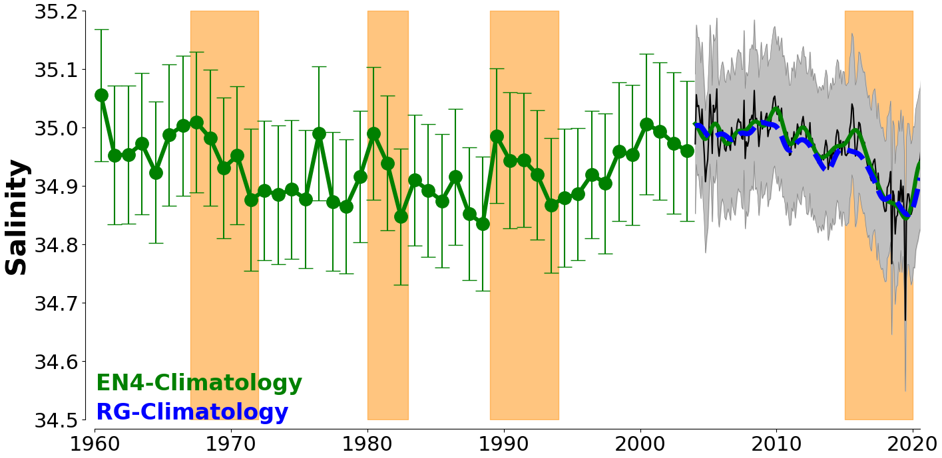
Result 2: The recent freshening is similar in amplitude and duration to previous GSAs
Average salinity within the upper (0-200 m) Irminger Sea
Past strong freshening events are consistent with previous GSAs (Belkin, 2004)
Lowest monthly salinity values since 1960 (Aug/2019)
Notes:
To obtain a better overview of the Irminger’s basin-wide salinity variability, we averaged the salinity signal seen in the animation, over the entire basin.
Here, the thick green and blue lines represent the this spatially averaged interannual salinity variability from both climatologies,
As you already know the 2015-2020 period is marked by a rapid freshening (click),
which resulted in the freshest state of the Irminger Sea since 1960;
In addition, the recent freshening is as rapid as previous strong events that are highlighted here by these orange bars (click).
IDue to the timing of these events, we believe they show previous Great Salinity Anomalies that propagated into the region.
The late 60’s and early 70’s event, for example, has been extensively documented, and it is known to have suppressed deep convection in the Labrador Sea for a few years (click)
So, did the same thing happen in the Irminger Sea after 2015?

Slide 7
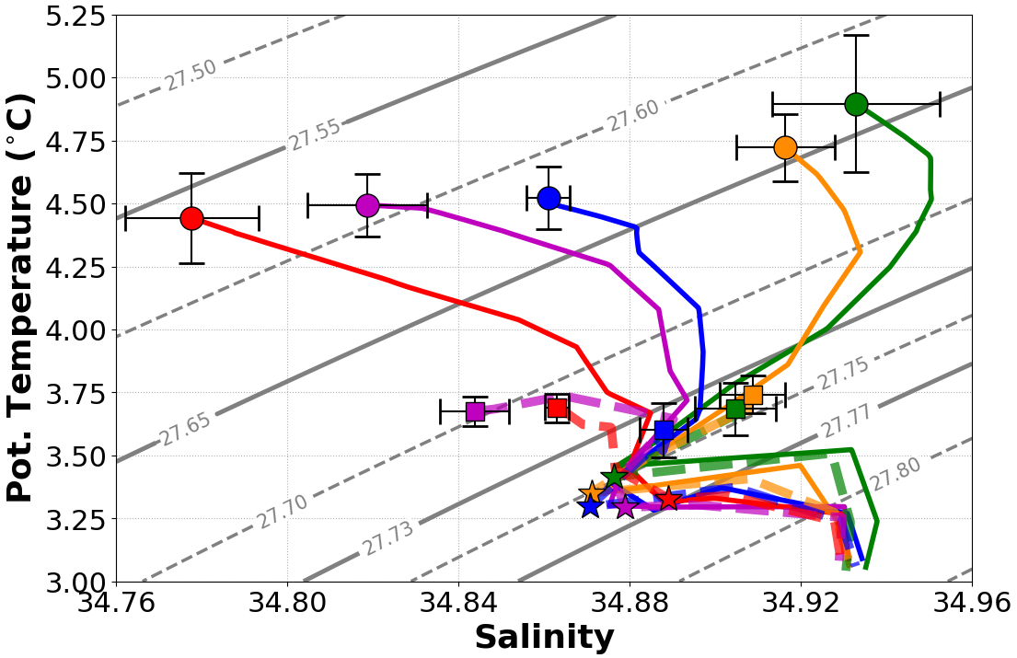
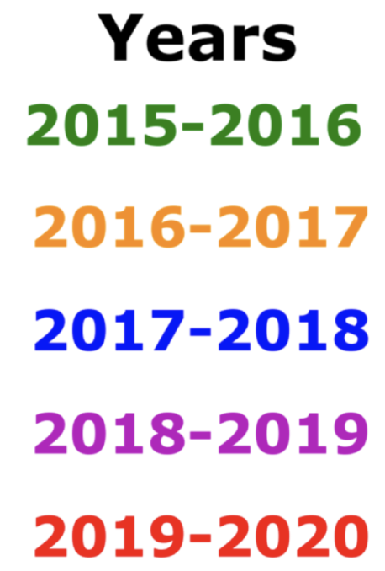
Result 3: Freshening helped suppress deep convection and made the ISIW fresher and lighter
Mooring records at the center of the basin (OOI-FLB)
Freshening drives the density changes within layers lighter than 27.73 kg m⁻³ (i.e., SPMW layer)
SPMW = Subpolar Mode Water
Solid = Late Fall Profile; Dashed = Late Winter Profile; Circles and Squares = Mixed Layer Properties; Stars = 1000 m properties
Notes:
Our mooring data and atmospheric reanalysis suggest the freshening indeed helped to suppress deep convection (with some big help form the atmosphere) and …
Made the Irminger Sea Intermediate Water fresher and lighter.
Here we show temperature-salinity profiles from our mooring records at the center of the basin. And why the center? Because it corresponds to area where deep convection can be active.
The solid profiles were taken in the Late Fall (right before convection season started), while the dashed profiles correspond to late winter (right at the end of the convection season).
The background lines are potential density isopycnals, and
the circles and squares correspond to the properties in the mixed-layer (click).
Note that pior to convection, the freshening drives the stratification changes over the years not temperature.
Meaning: the upper ocean became more buoyant due to the freshening.
Specially in the Subpolar Mode Water layer (click).

Slide 8
Result 3: Freshening helped suppress deep convection and made the ISIW fresher and lighter
Mooring records at the center of the basin (OOI-FLB)
Freshening drives the density changes within layers lighter than 27.73 kg m⁻³ (i.e., SPMW layer)
Fall of 2019, the SPMW signature disappears
?
Solid = Late Fall Profile; Dashed = Late Winter Profile; Circles and Squares = Mixed Layer Properties; Stars = 1000 m properties
Notes:
Now, the mode waters corresponds to modified salty waters of subtropical origin.
So, it is characterized by a salinity subsurface maximum which completely disappears in 2019.
This could indicate that the fresh anomaly could also be connected to a decrease of subtropical water fluxes to the subpolar gyre, which has been subject of a few recent studies (click).

Slide 9
Result 3: Freshening helped suppress deep convection and made the ISIW fresher and lighter
Mooring records at the center of the basin (OOI-FLB)
Freshening drives the density changes within layers lighter than 27.73 kg m⁻³ (i.e., SPMW layer)
Fall of 2019, the SPMW signature disappears
Winters 2015-2017: ML 740-1400 m (i.e., deep convection)
Solid = Late Fall Profile; Dashed = Late Winter Profile; Circles and Squares = Mixed Layer Properties; Stars = 1000 m properties
Notes:
Wintertime properties also changed, and again, mainly in the salinity space …
During winters between 2015-2017, mixed layer depths varied from 740 to1400 m allowing deep convection to happen (click) …

Slide 10
Result 3: Freshening helped suppress deep convection and made the ISIW fresher and lighter
Mooring records at the center of the basin (OOI-FLB)
Freshening drives the density changes within layers lighter than 27.73 kg m⁻³ (i.e., SPMW layer)
Fall of 2019, the SPMW signature disappears
Winters 2015-2017: ML 740-1400 m (i.e., deep convection)
Winters 2018-2019 and 2019-2020: ML < 400 m and ISIW fresher and lighter (i.e., shallower convection)
Notes:
In contrast, during the following winters, mixed layers didn’t exceed 400 m (so no deep convection) and
The Irminger Intermediate Waters became significantly fresher and lighter …
The question then becomes: how important was the freshening for this deep convection suppression (click).

Slide 11
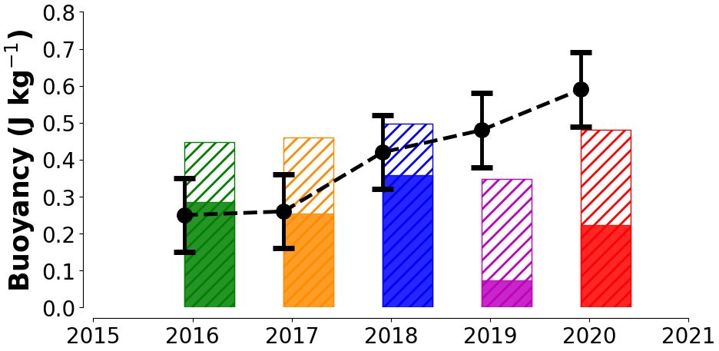
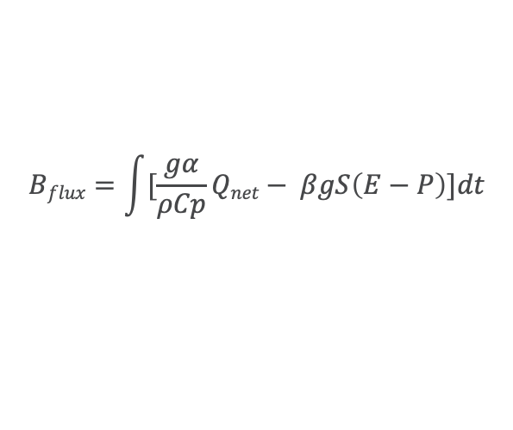
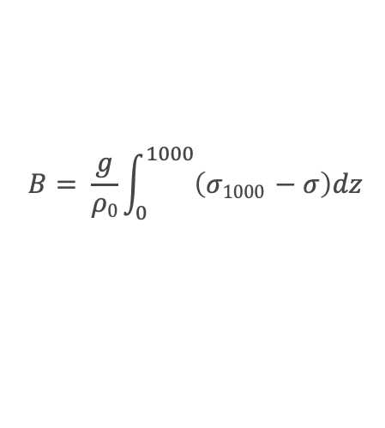
Result 3: Freshening helped suppress deep convection and made the ISIW fresher and lighter
OOI-FLB buoyancy (B) content prior to convection season (dots) and ERA5 buoyancy removed from the ocean by the atmosphere during during winter (solid bars)
$$B= \frac{g}{ρ0}\int_{0}^{1000}{\left(σ1000 −σ\right)dz}$$
$$Bflux=\int{[\frac{gα}{ρCp}Qnet− βgS\left(E−P\right)]dt}$$
Schmidt & Send (2007)
Gill (1982)
B doubled
Notes:
And the answer is “very”.
Here we are showing the Buoyancy content (B) of the late fall profiles (little black dots) calculated following Schmidt and Send,
where g is acceleration due to gravity, rho-zero is the reference density, and sigma is the potential density.
This also can be interpreted as the amount of buoyancy that the atmosphere need to remove from the ocean during winter, to homogenized the upper 1000 m (or allow deep convection).
The solid bars, on the other hand, are the amount of buoyancy removed from the ocean by the atmosphere via surface heat fluxes (the hateched bars) plus freshwater fluxes (click)
Note that since 2015, the buoyancy content nearly doubled mainly due to salinity. Meaning, it became harder for the atmosphere to drive deep convection.
Of course, the salinity is not the only one to blame for the weak convection between 2019 and 2020.
In fact, the 2018-2019 winter was relatively warm. See how the magenta solid bar is small compared to the other ones.
However, the 2019-2020 winter was as cold as the first three winters and still no deep convection.
Of course, this period was also more rainy (which caused the large differences between the red hatched bar and solid bar), but
If the buoyancy content had not doubled, the red solid bar would intercept the dot within the errors, and
a more significant deeper convection would had developed
Which shows the salinity changes played an active role in suppressing the deep convection in the Irminger Sea (click).

Slide 12
Take home Messages
Within the Irminger Sea, the anomaly was rapidly advected by the boundary currents while slowly spreading to the basin center
Fresh anomaly identified in the Iceland Basin exhibits characteristics of a GSA as it spreads into the Irminger Sea
Extreme freshening played an important role in suppressing the deep convection in the Iminger Sea during the 2018-2019 and 2019-2020 winters
Biló, T. C., F. Straneo, J. Holte, and I. A.-A. Le Bras, 2022: Arrival of New Great Salinity Anomaly Weakens Convection in the Irminger Sea. Under Review in Geophys. Res. Lett..
Notes:
Before you pause this video, I want you to take home 3 main messages:
1 –
2 –
And last but not least …
3 –
(click)
Finally, I hope you all can read more about this in the Geophysical Research Letters soon (we submitted the paper and is under review).

Slide 13
Questions or comments
References
Belkin, I. M. (2004). Propagation of the “Great Salinity Anomaly” of the 1990s Around the Northern North Atlantic. Geophysical Research Letters, 31 (8), L08306. doi: 10.1029/2003GL019334
de Jong, F. M., van Aken, H. M., Vage, K., & Pickart, R. S. (2012). Convective Mixing in the Central Irminger Sea: 2002–2010. Deep Sea Research Part I: Oceanographic Research Papers, 63 , 36–51. doi: 10.1016/j.dsr.2012.01.003
Dee, D. P., Uppala, S. M., Simmons, A. J., Berrisford, P., Poli, P., Kobayashi, S., . . . Vitart, F. (2011). The ERA-Interim reanalysis: configuration and performance of the data assimilation system. Quarterly Journal of the Royal Meteorological Society, 137 (656), 553–597. doi: 10.1002/qj.828
Gill, A. E. (1982). Atmosphere-Ocean Dynamics. San Diego, United States of America: Academic Press.
Good, S. A., Martin, M. J., & Rayner, N. A. (2013). EN4: Quality controlled ocean temperature and salinity profiles and monthly objective analyses with uncertainty estimates. Journal of Geophysical Research: Oceans, 118 (12), 6704–6716. doi: 10.1002/2013JC009067
Holliday, P. N., Bersch, M., Berx, B., Chafik, L., Cunningham, S., Florindo-Lopez, C., . . . Yashayaev, Y. (2020). Ocean circulation causes the largest freshening event for 120 years in eastern subpolar North Atlantic. Nature Communica461 tions, 11 (1), 585. doi: 10.1038/s41467-020-14474-y
Le Bras, I. A. A.-A., Straneo, F., Holte, J., de Jong, F. M., & Holliday, P. N. 486 (2020). Rapid Export of Waters Formed by Convection Near the Irminger Sea’s Western Boundary. Geophysical Research Letters, 47 (3). doi: 10.1029/2019GL085989
Roemmich, D., & Gilson, J. (2009). The 2004-2008 mean and annual cycle of temperature, salinity, and steric height in the global ocean from the Argo Program. Progress in Oceanography, 82 (2), 81–100.
Schmidt, S., & Send, U. (2007). Origin and Composition of Seasonal Labrador Sea Freshwater. Journal of Physical Oceanography, 37 (6), 1445–1454. doi: 10.1175/JPO3065.1
Tesdal, J.-E., Abernathey, R. P., Goes, J. I., Gordon, A. L., & Haine, T. W. N. (2018). Salinity Trends within the Upper Layers of the Subpolar North Atlantic. Journal of Climate, 31 (7), 2675–2698. doi: 10.1175/JCLI-D-17-0532.1
https://www.o-snap.org/
Email me: tcarrilhobilo@ucsd.edu
Presentation on Friday 03/04 03:30 – 04:30 PM EST
Abstract Id#4821 @ PL05 Ventilation, circulation, and mixing of the deep ocean
Notes:
Thank you for watching and If you have any comments or questions, feel free to email me or chat with me on Friday March 4th between 03:30 – 04:30 Pm EST.

